Slide 1
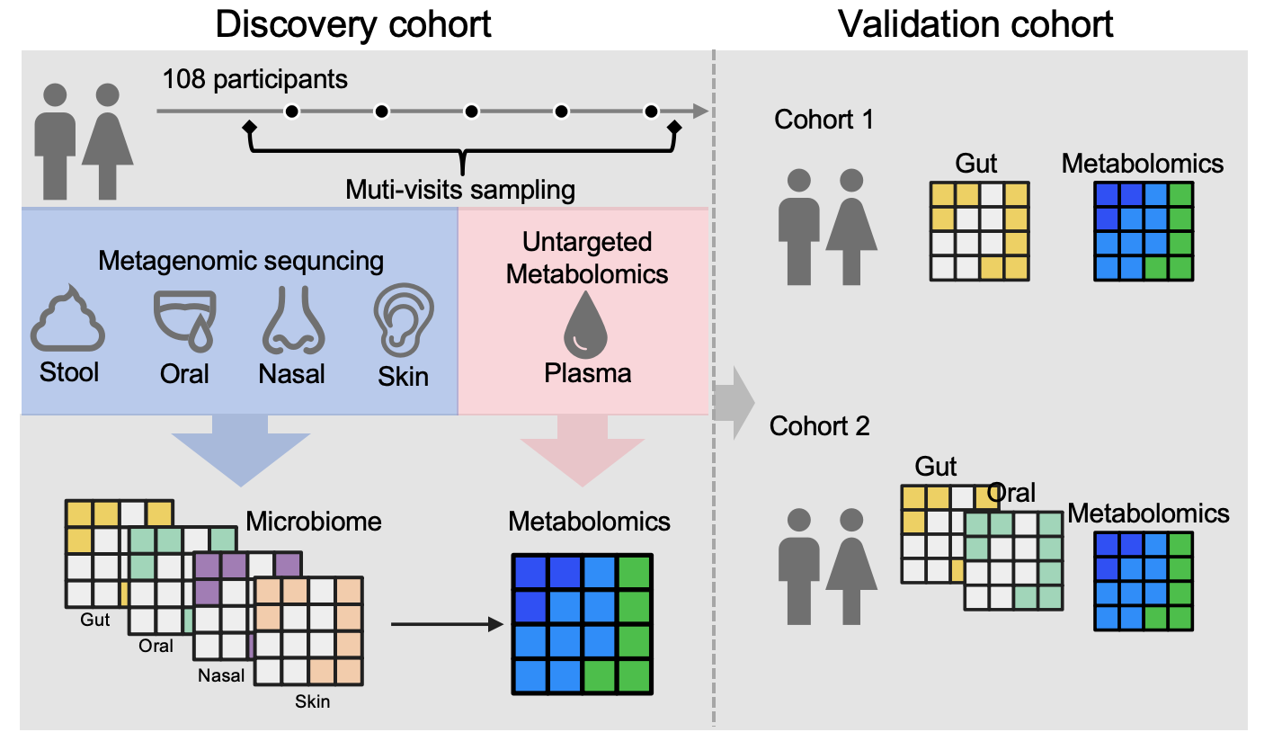
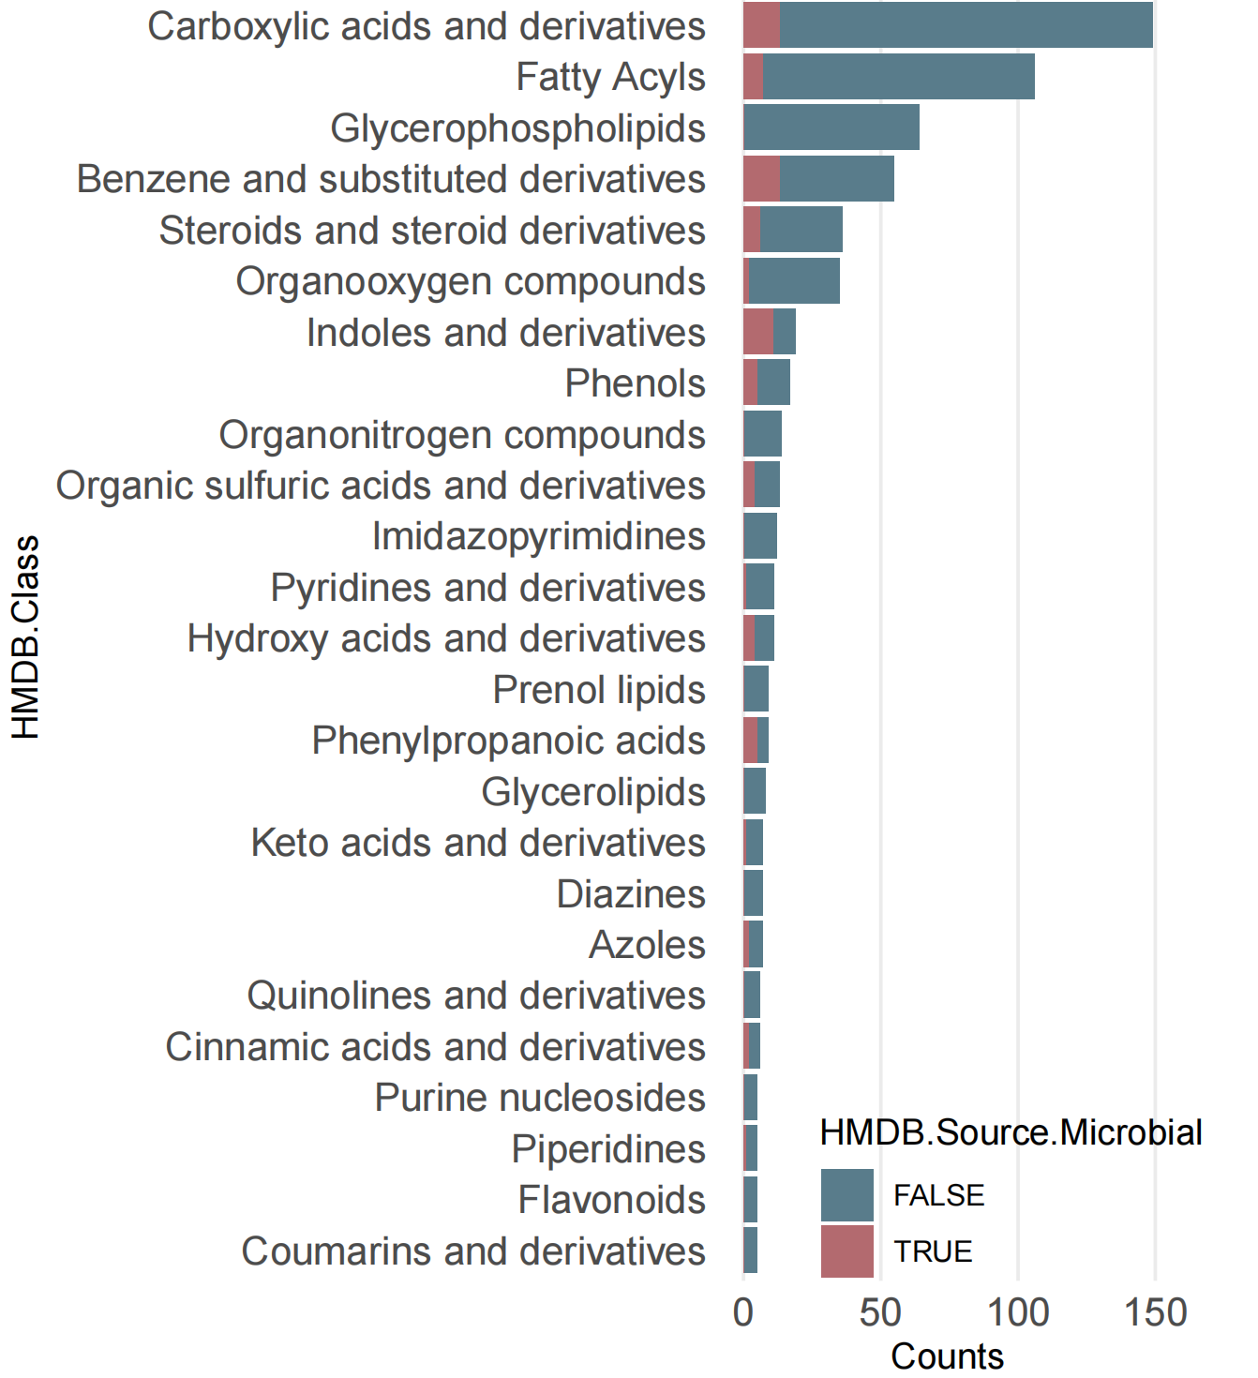
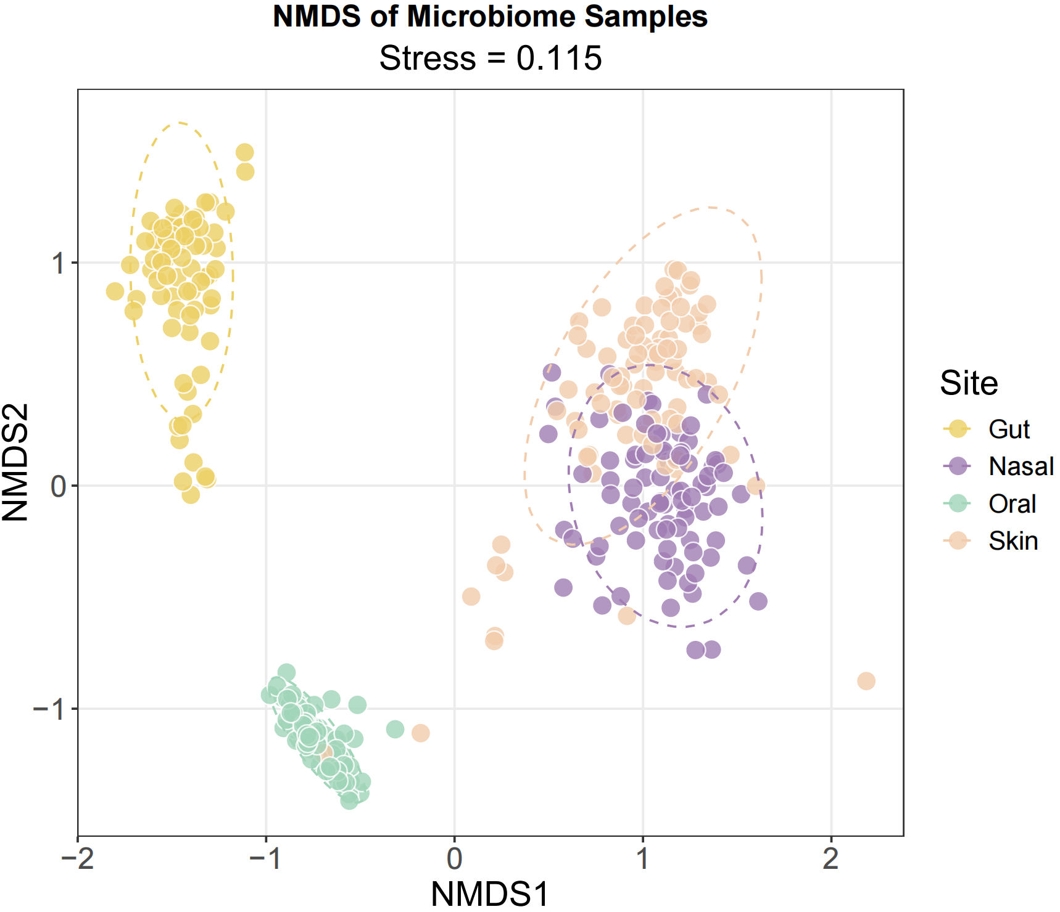
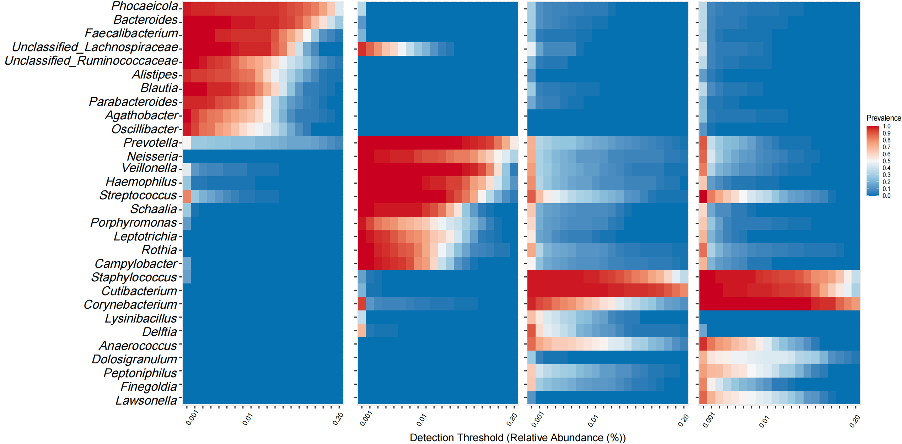
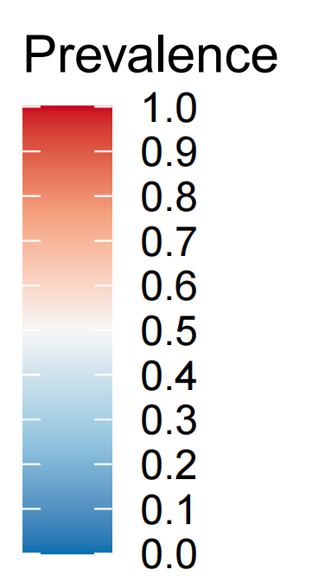
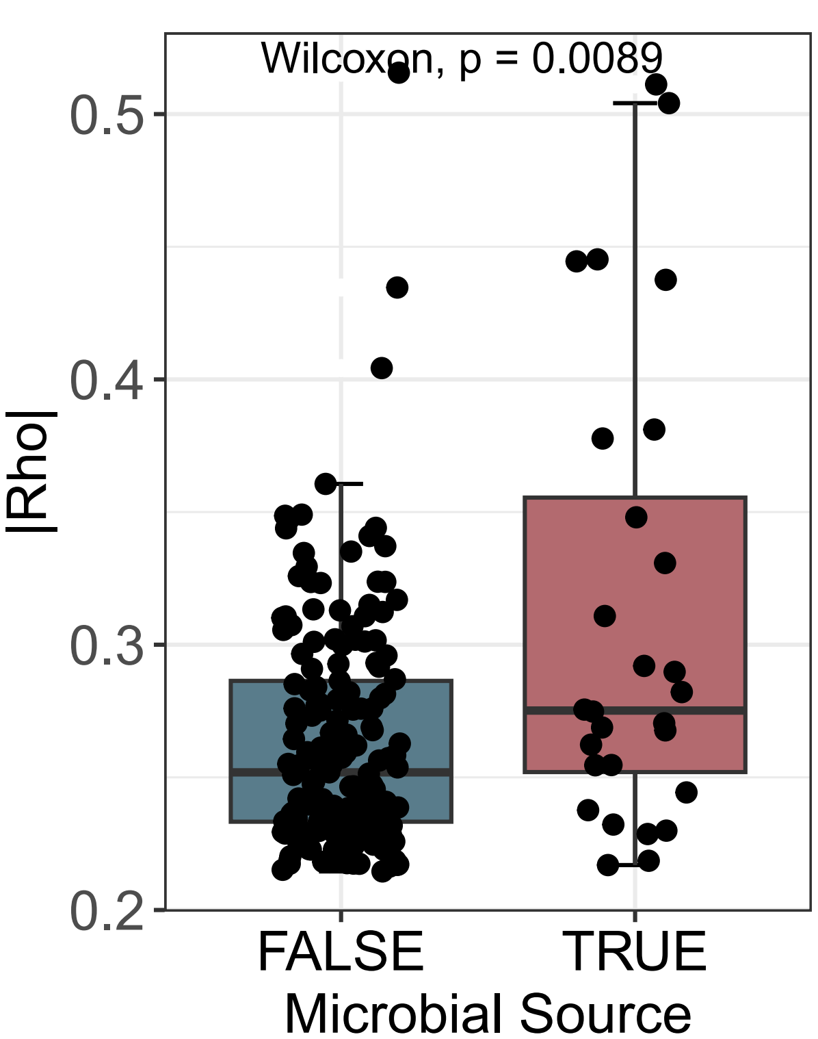
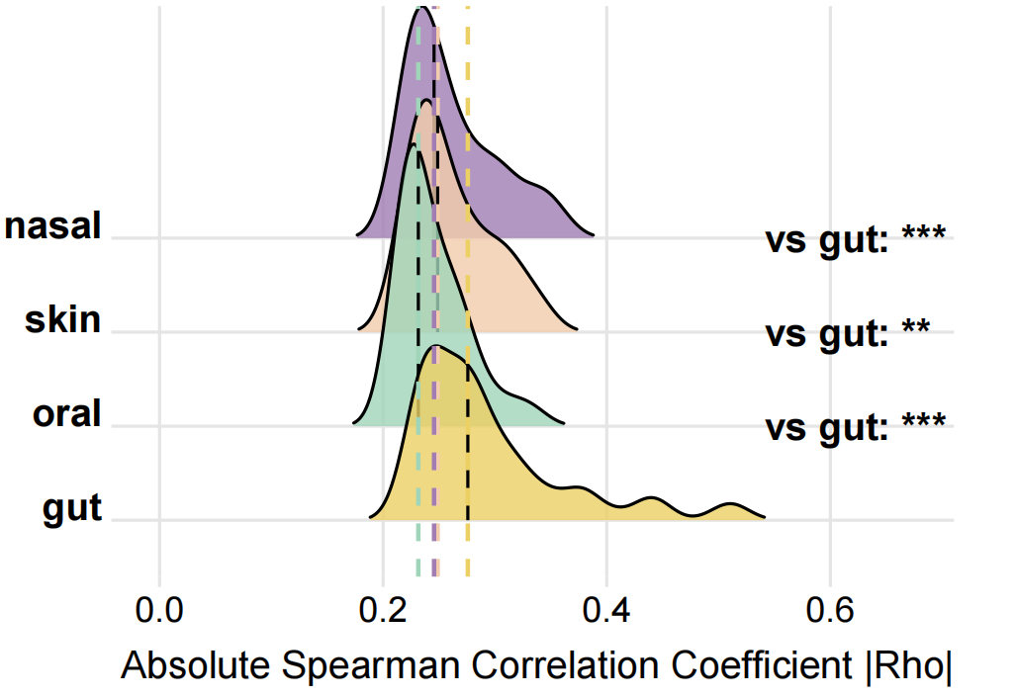
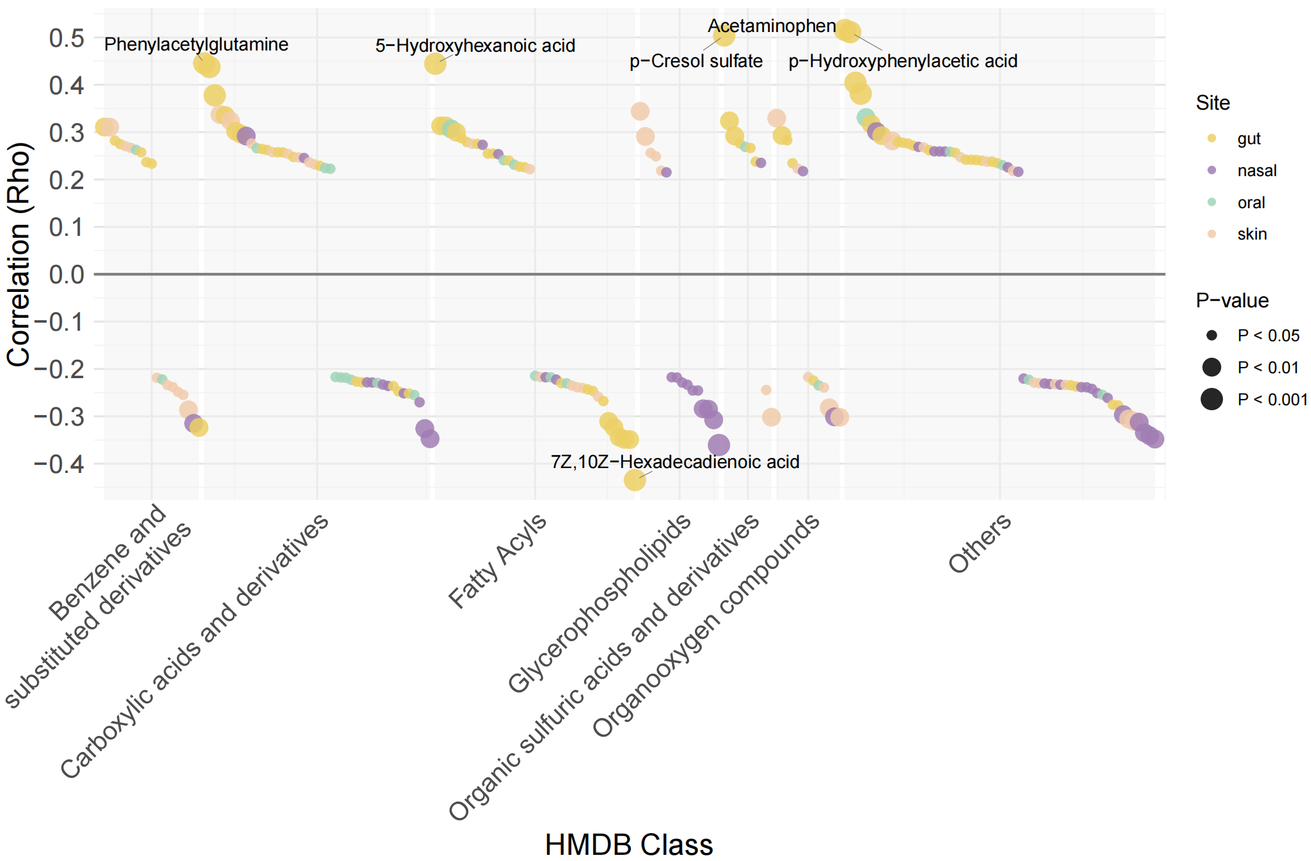
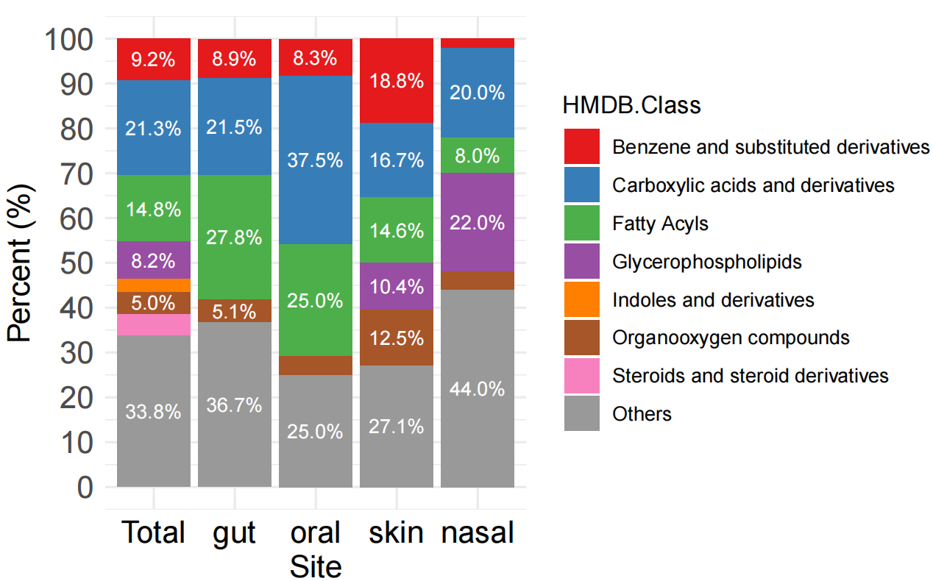
Figure1
a
b
c
d
Gut
Oral
Skin
Nasal
e
f
g
h

Slide 2
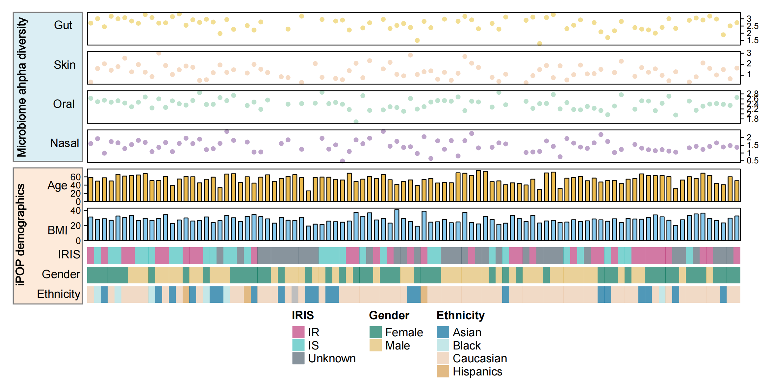
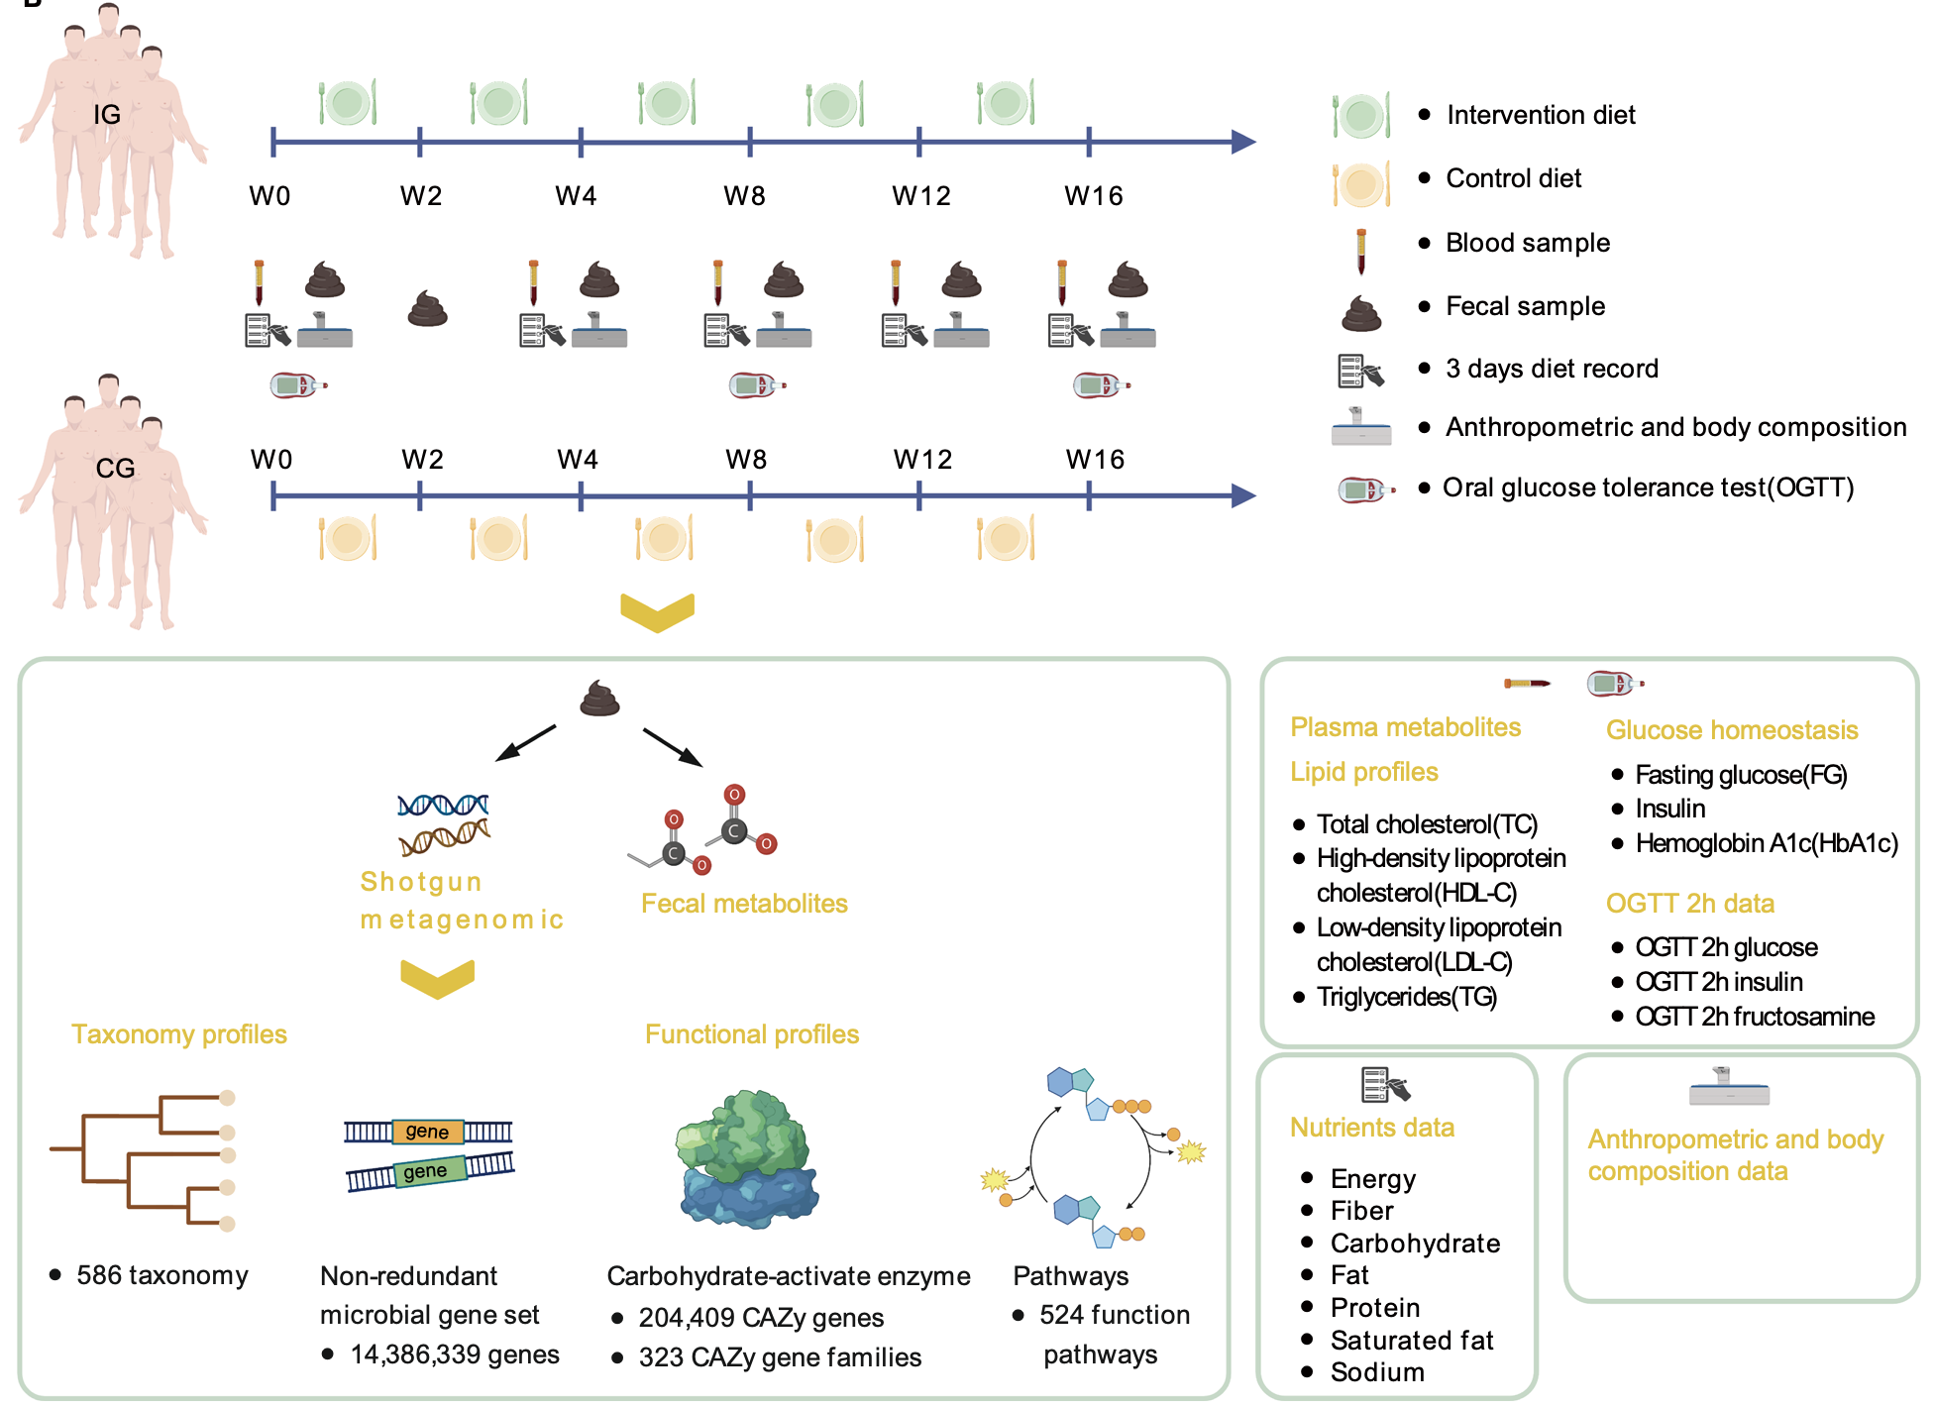
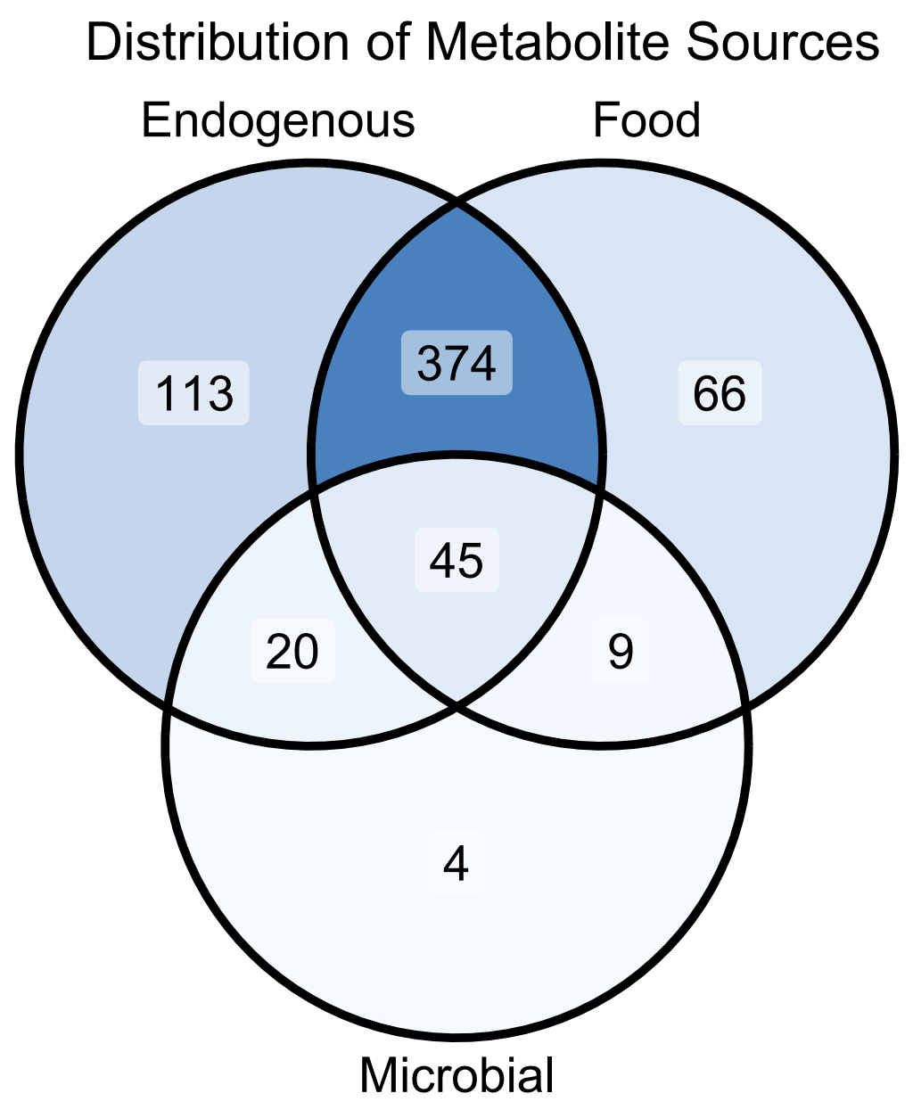
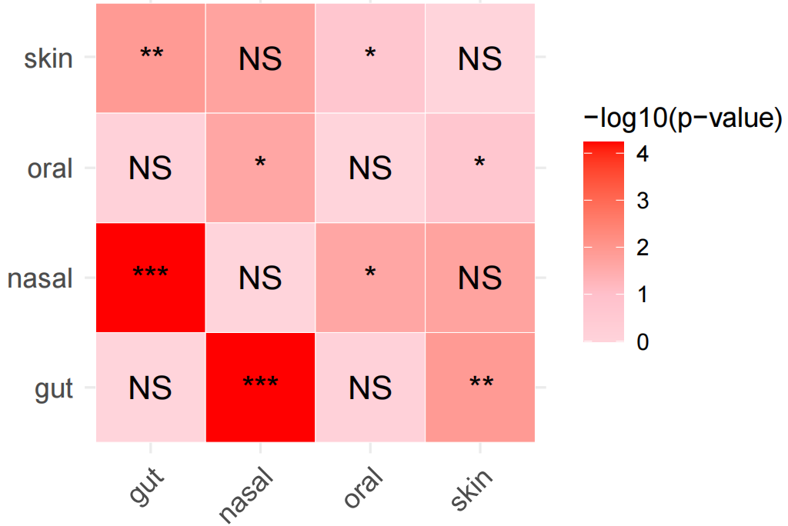
Extended Data Fig. 1
外部数据demographic
外部数据demographic
Notes:
metabolite class

Slide 3
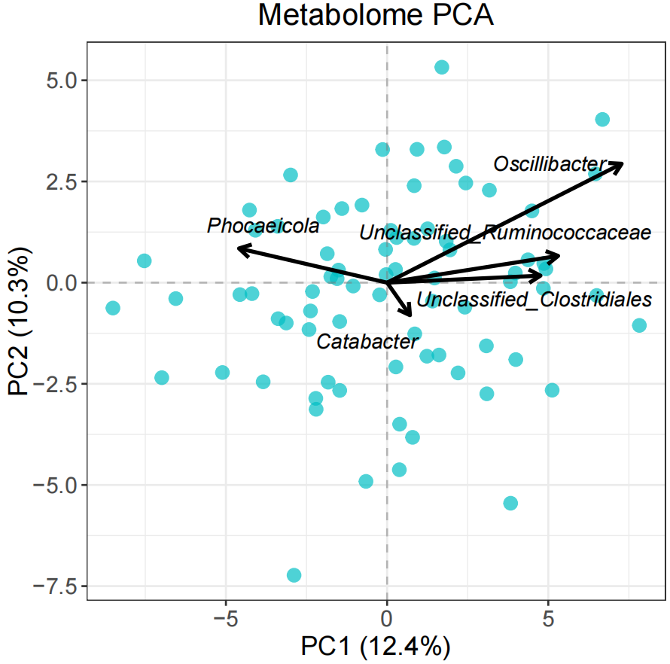
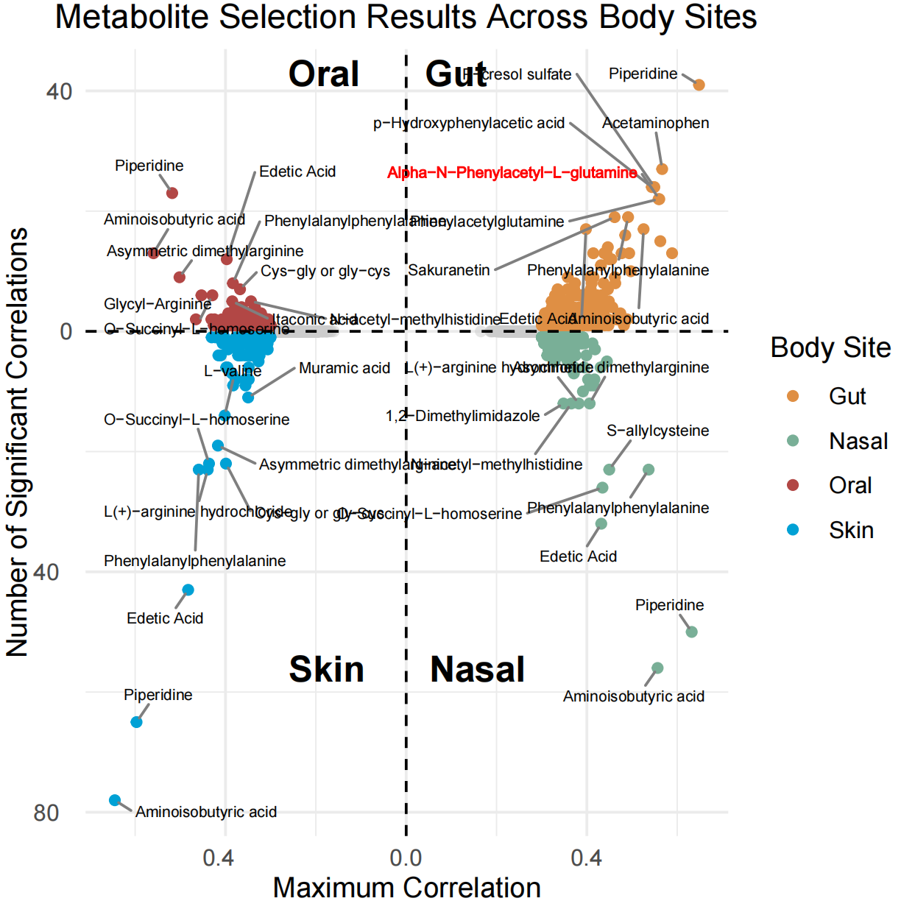
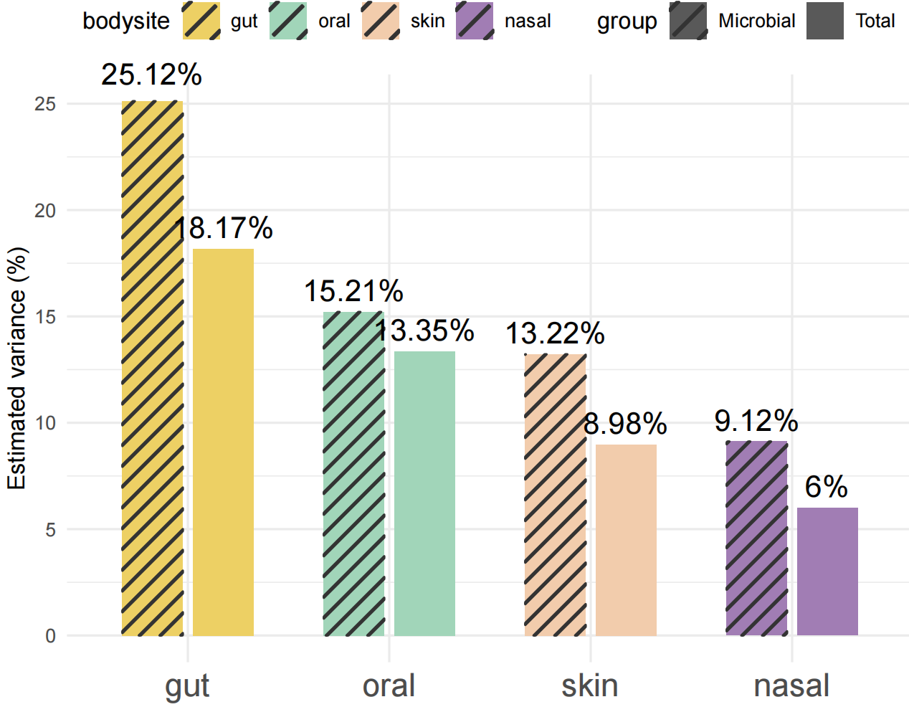
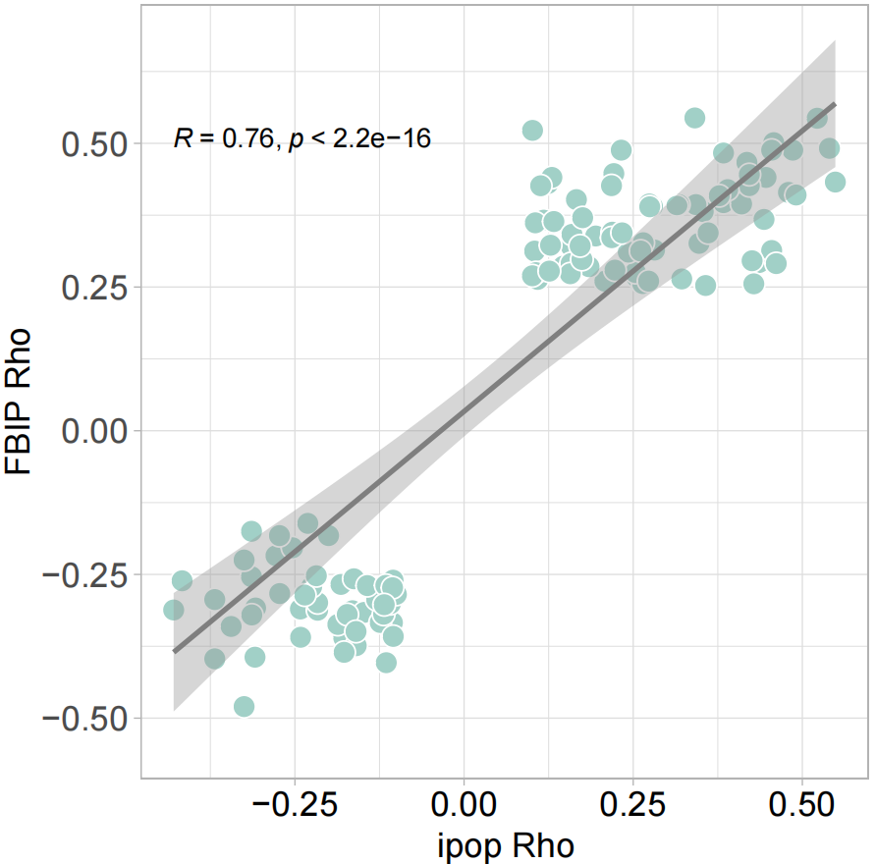
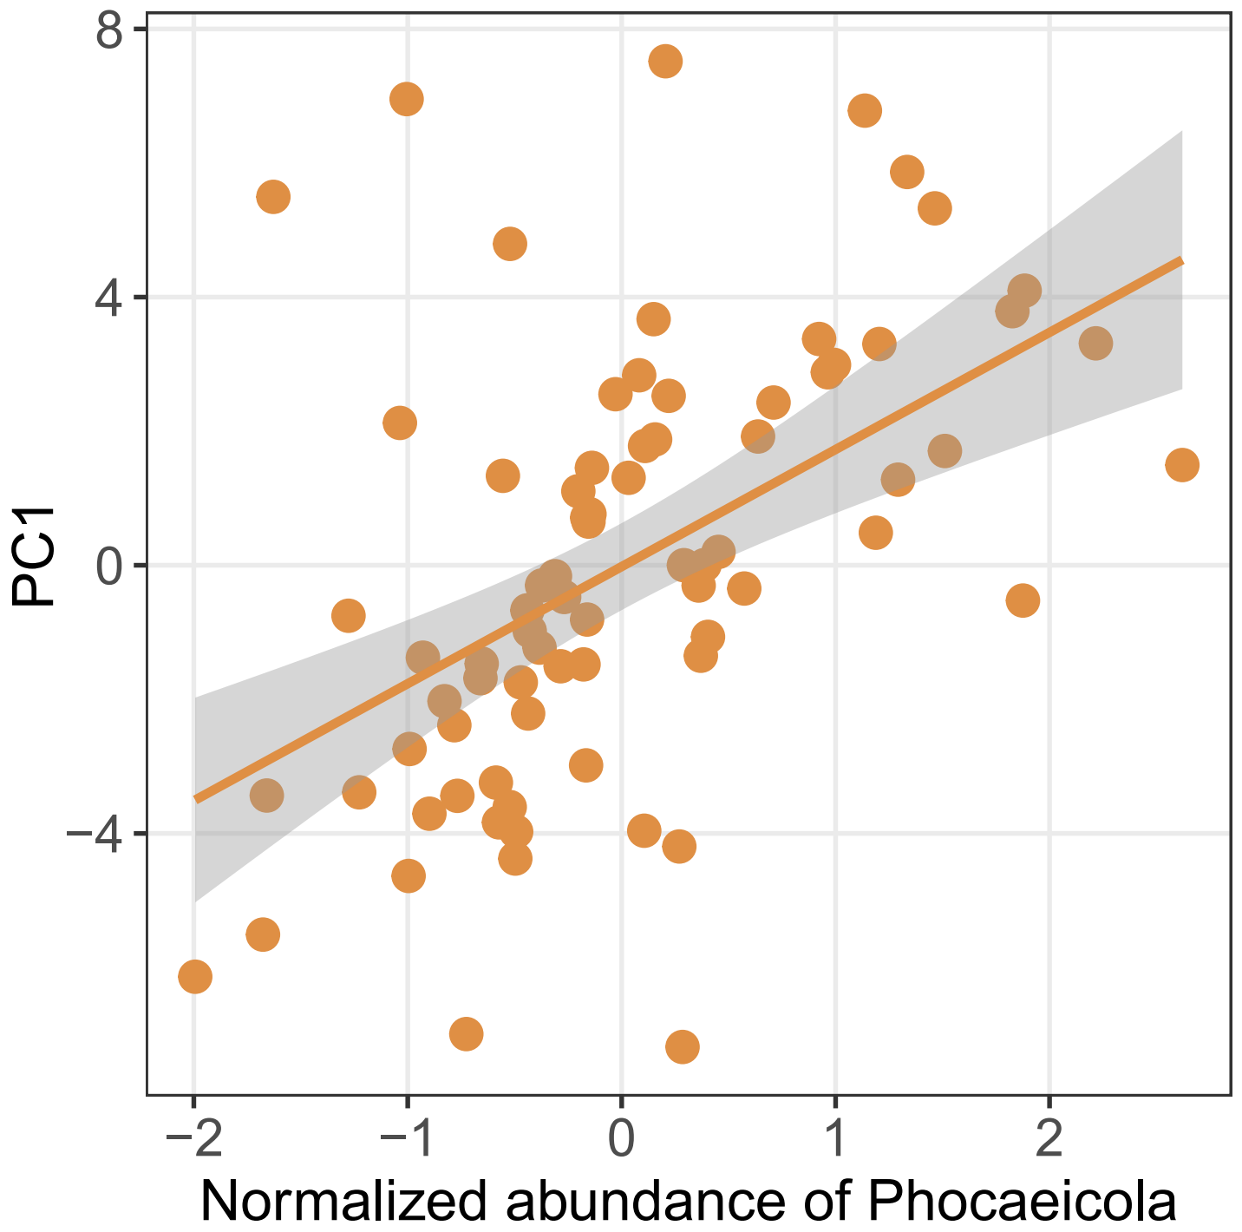
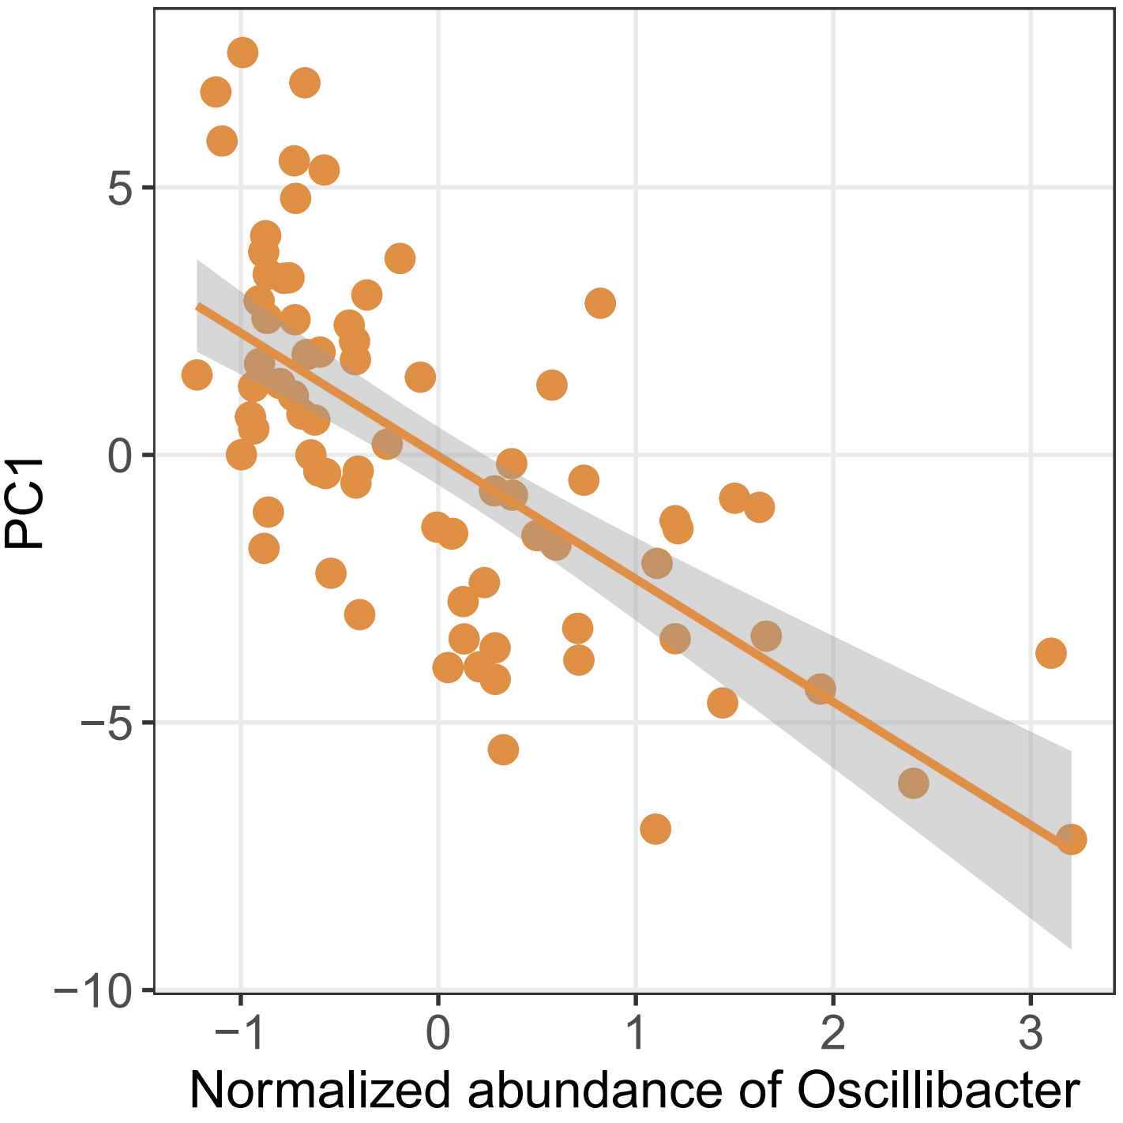
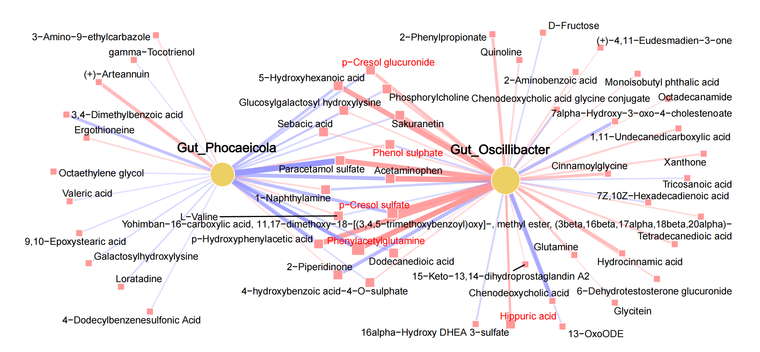
Figure2
Notes:
figure 2b 分开microbiome derived代谢物的adonis a 家

Slide 4
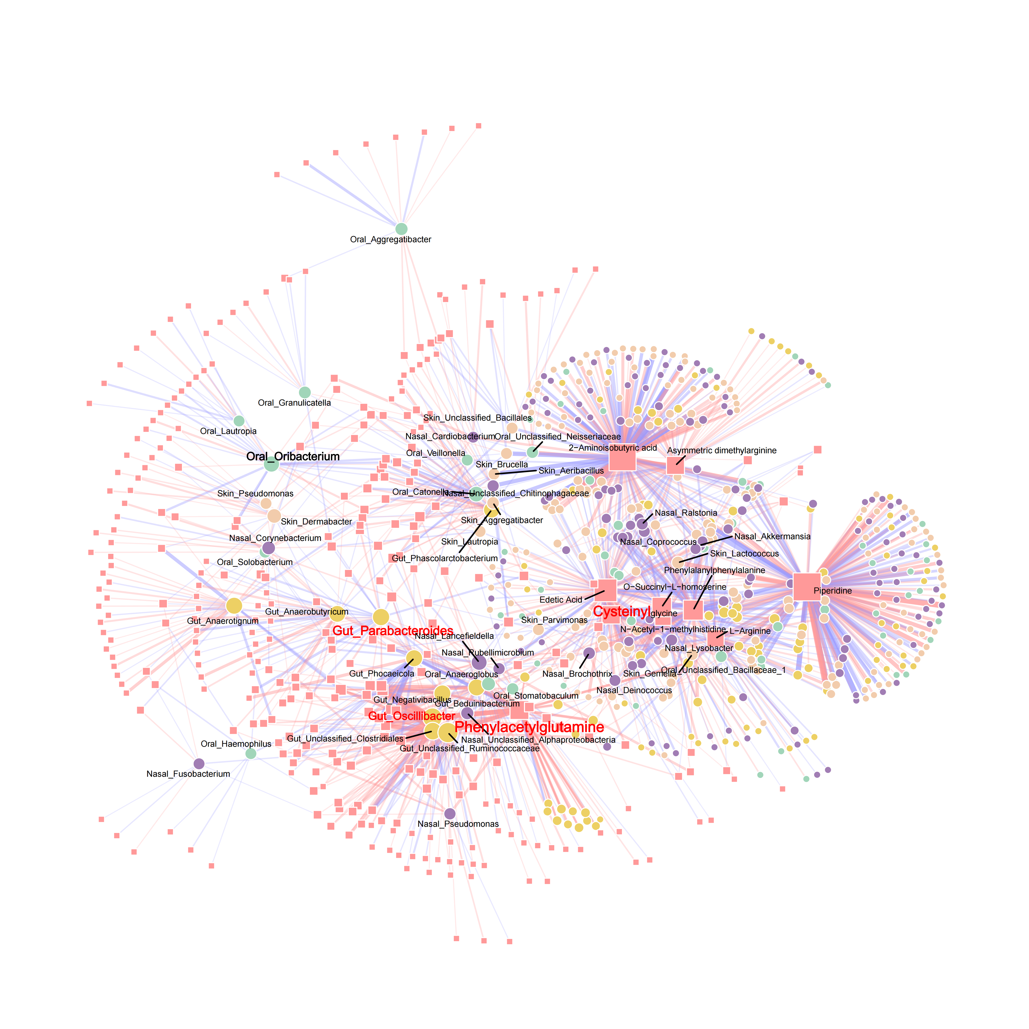
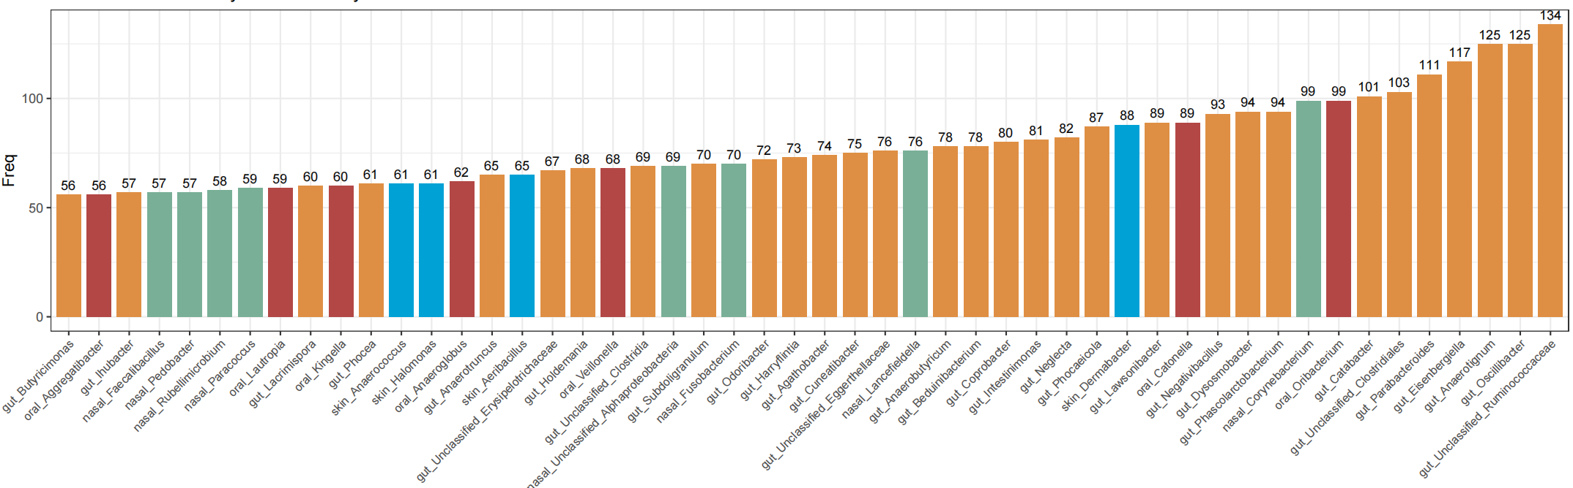
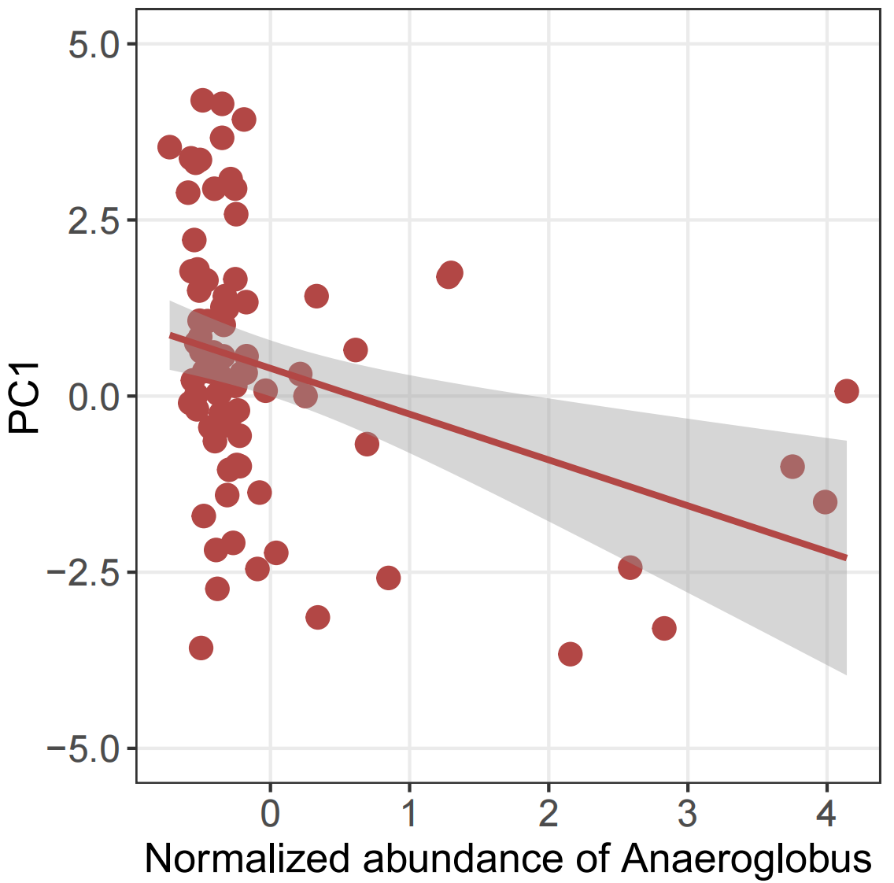
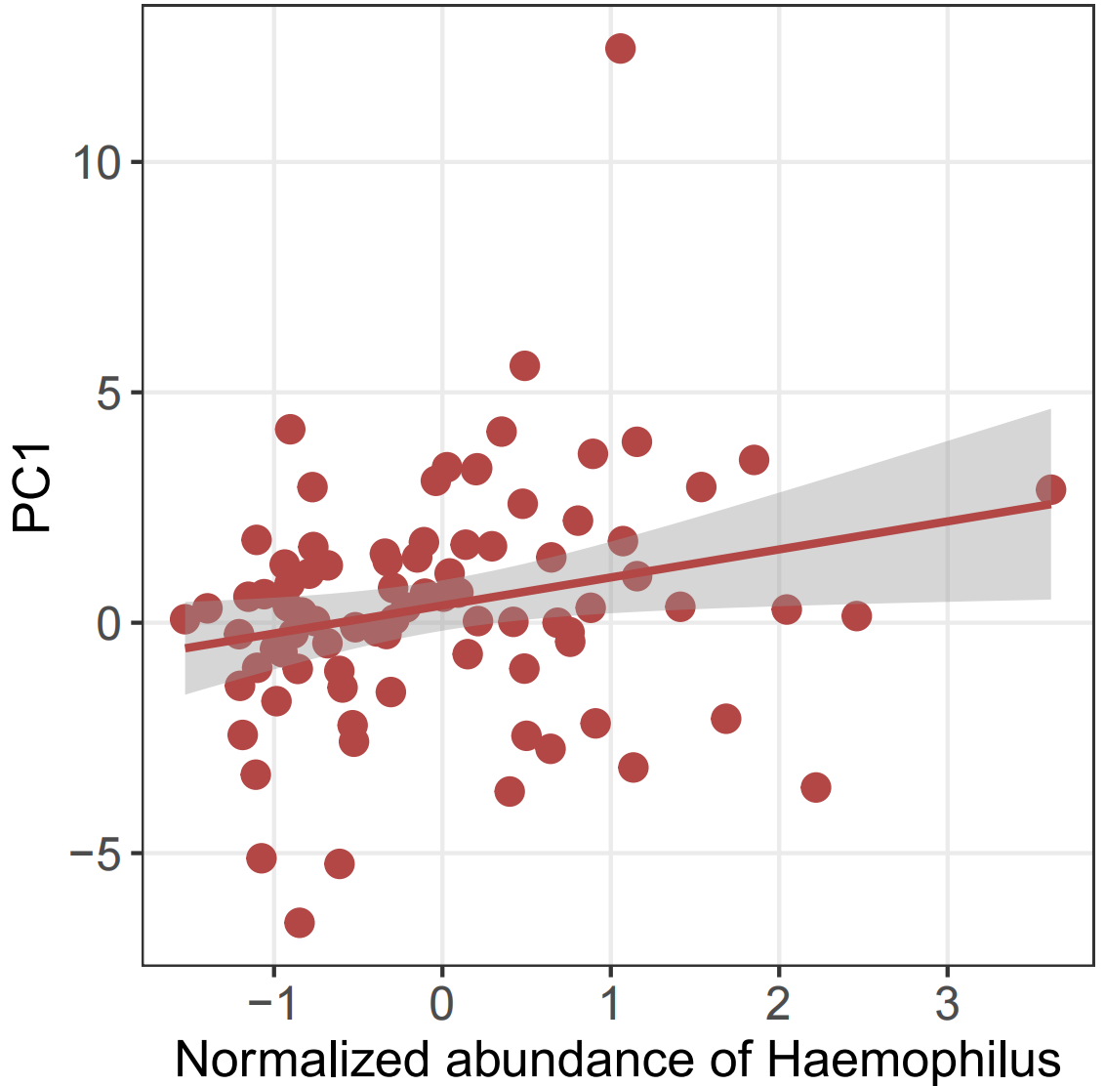
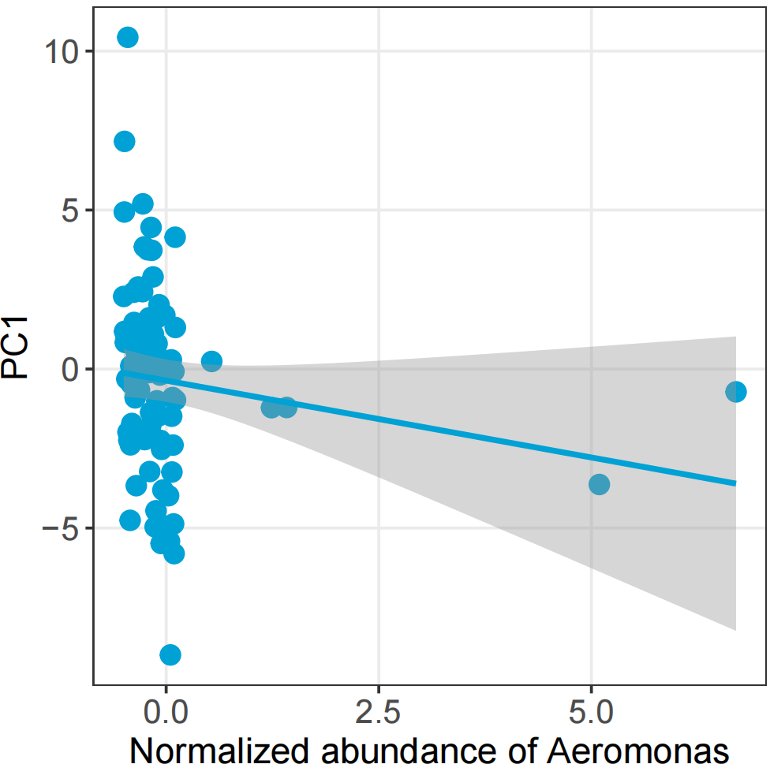
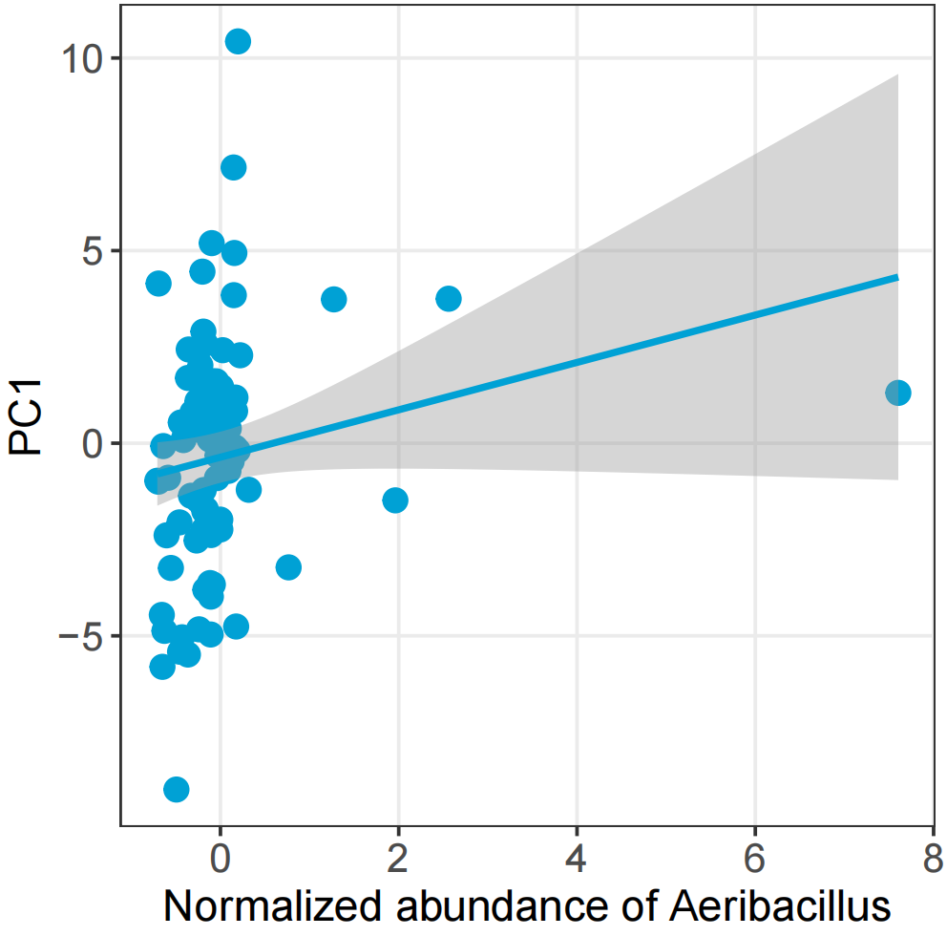
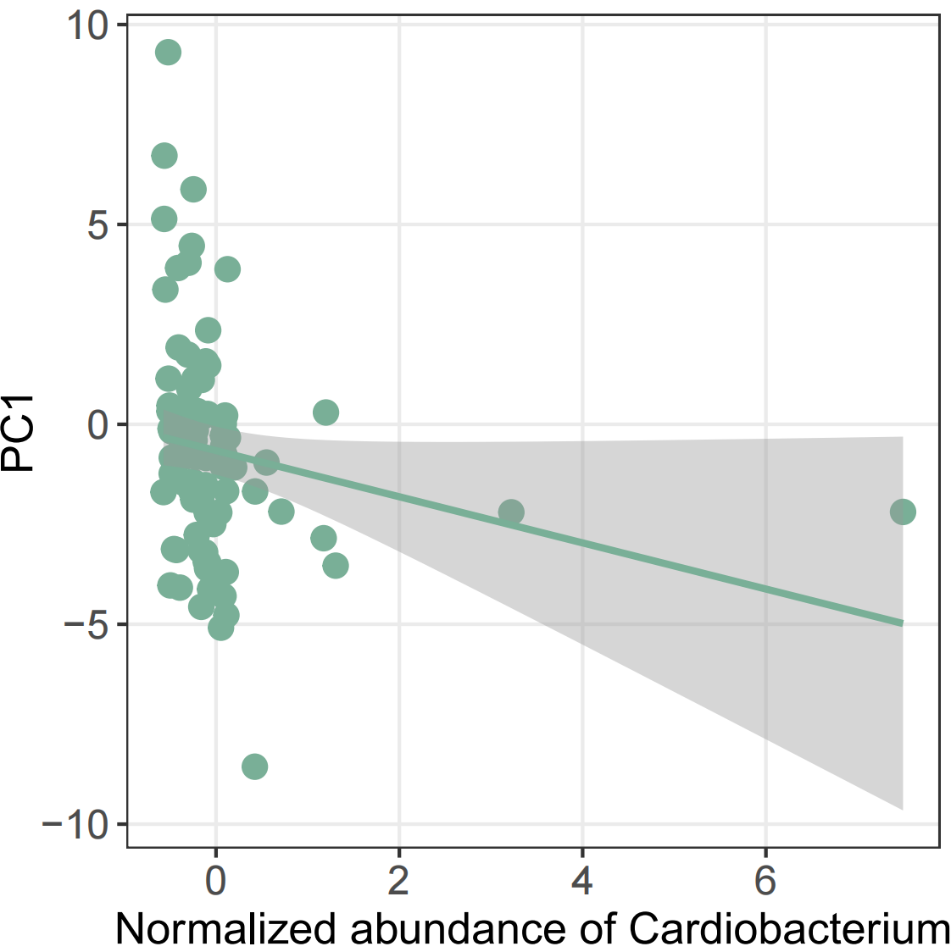
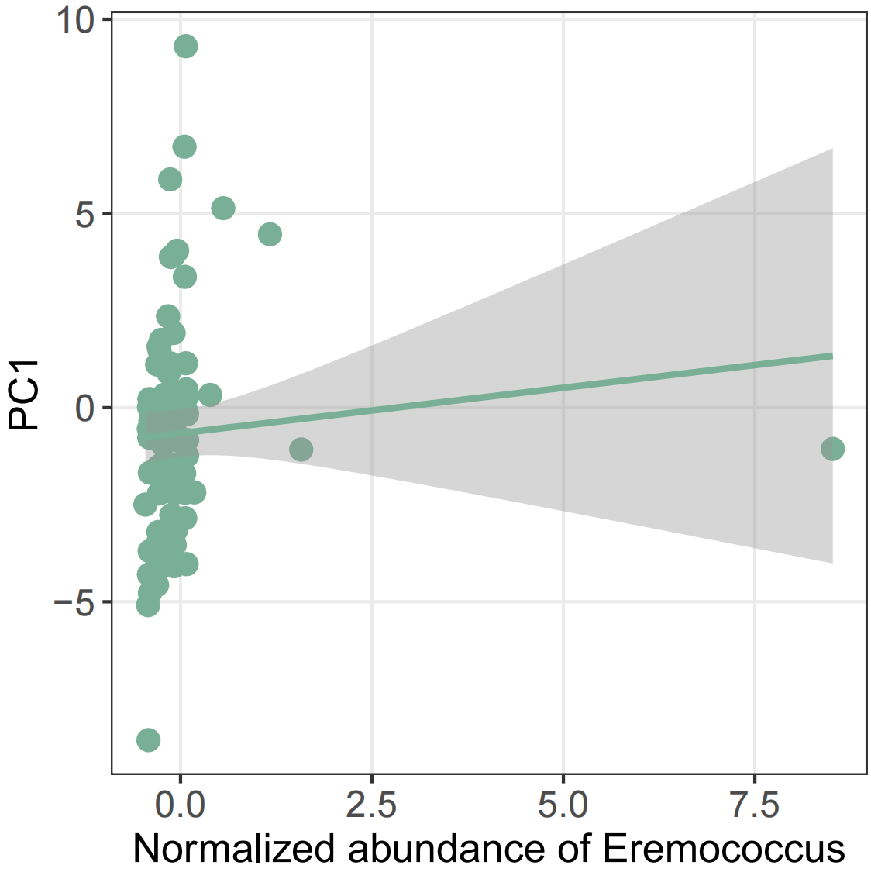
Extended Data Fig. 2

Slide 5
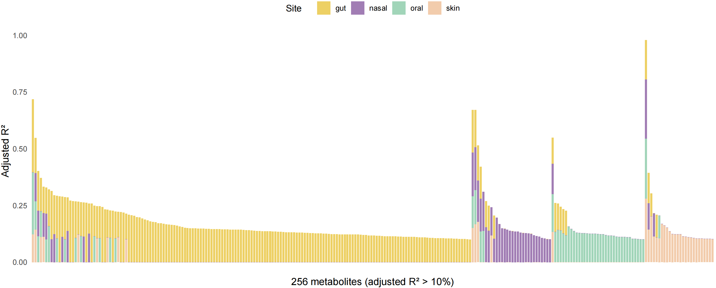
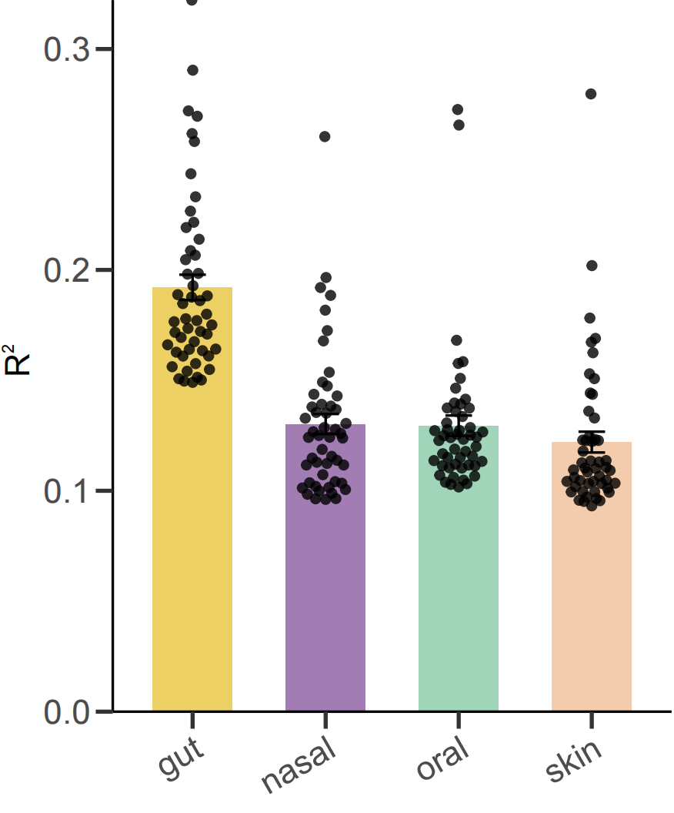
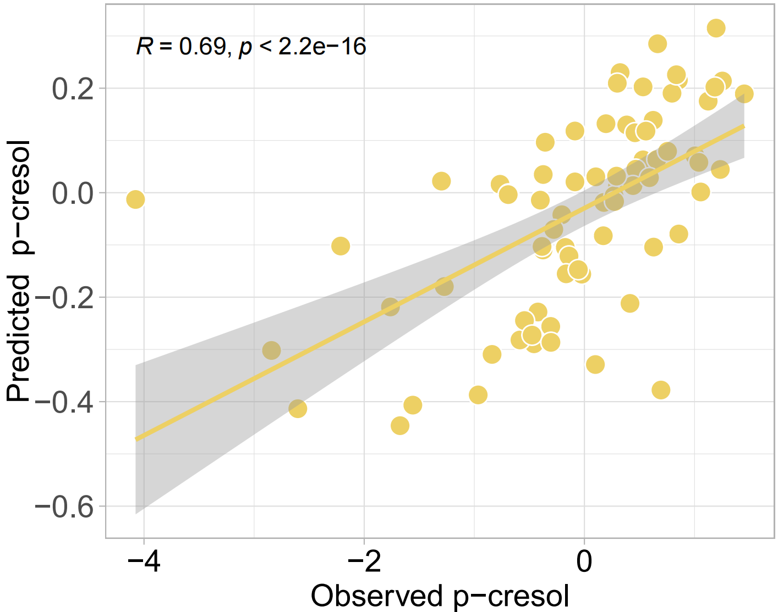
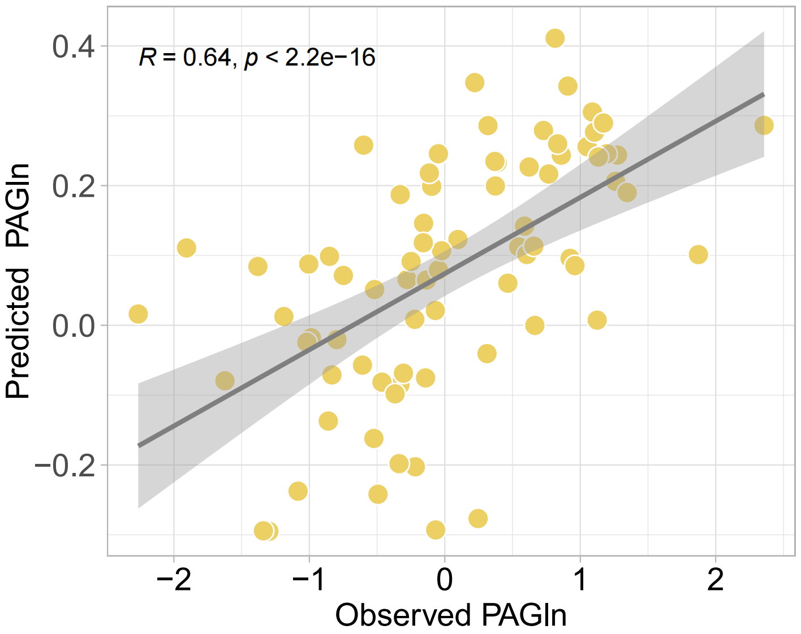
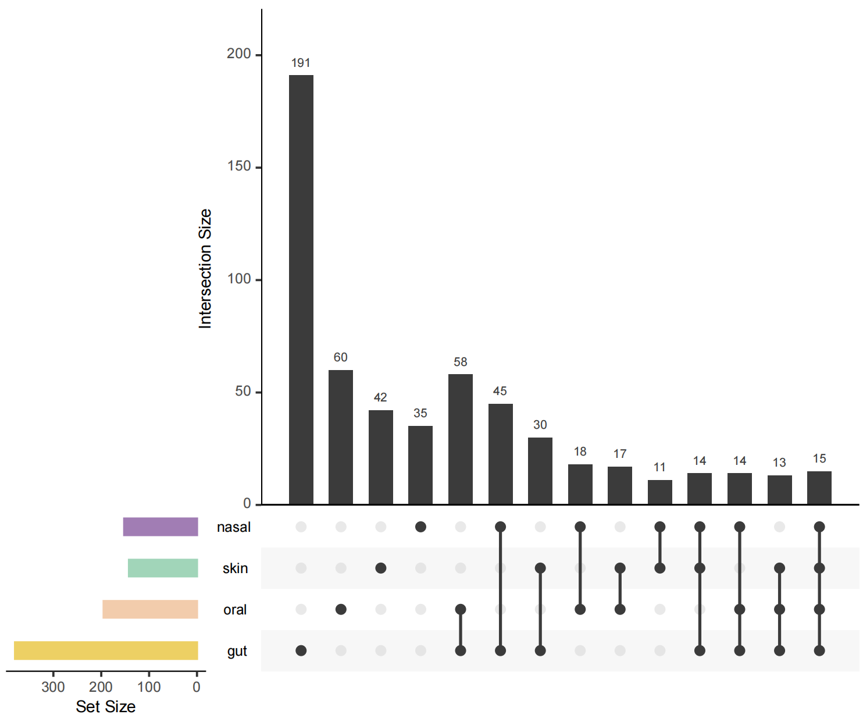
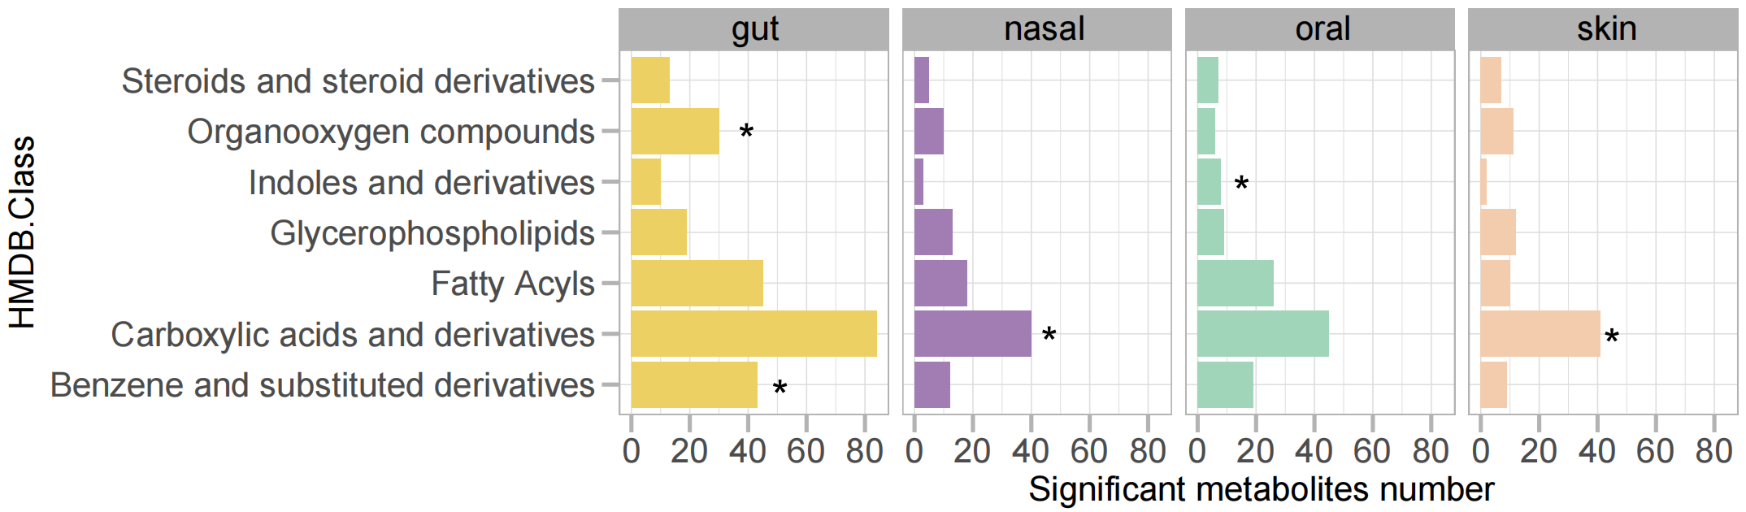
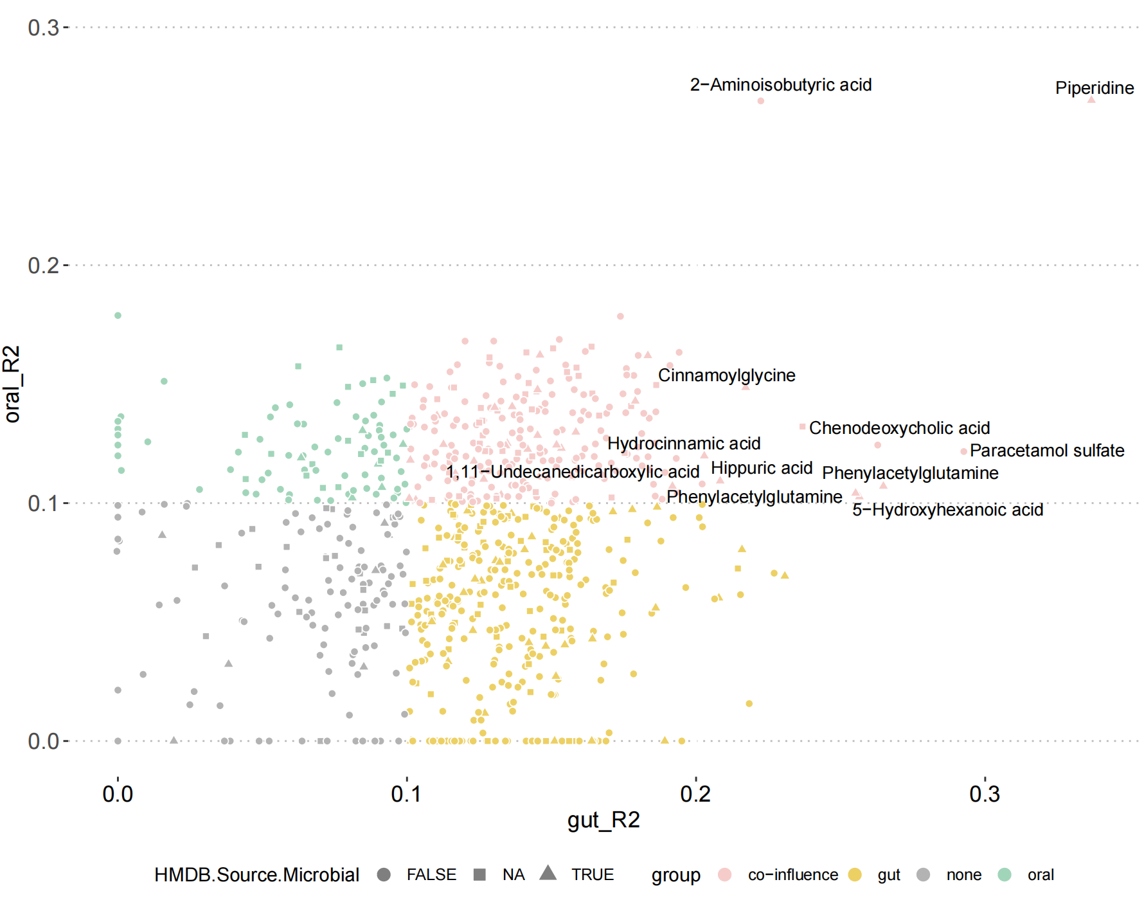
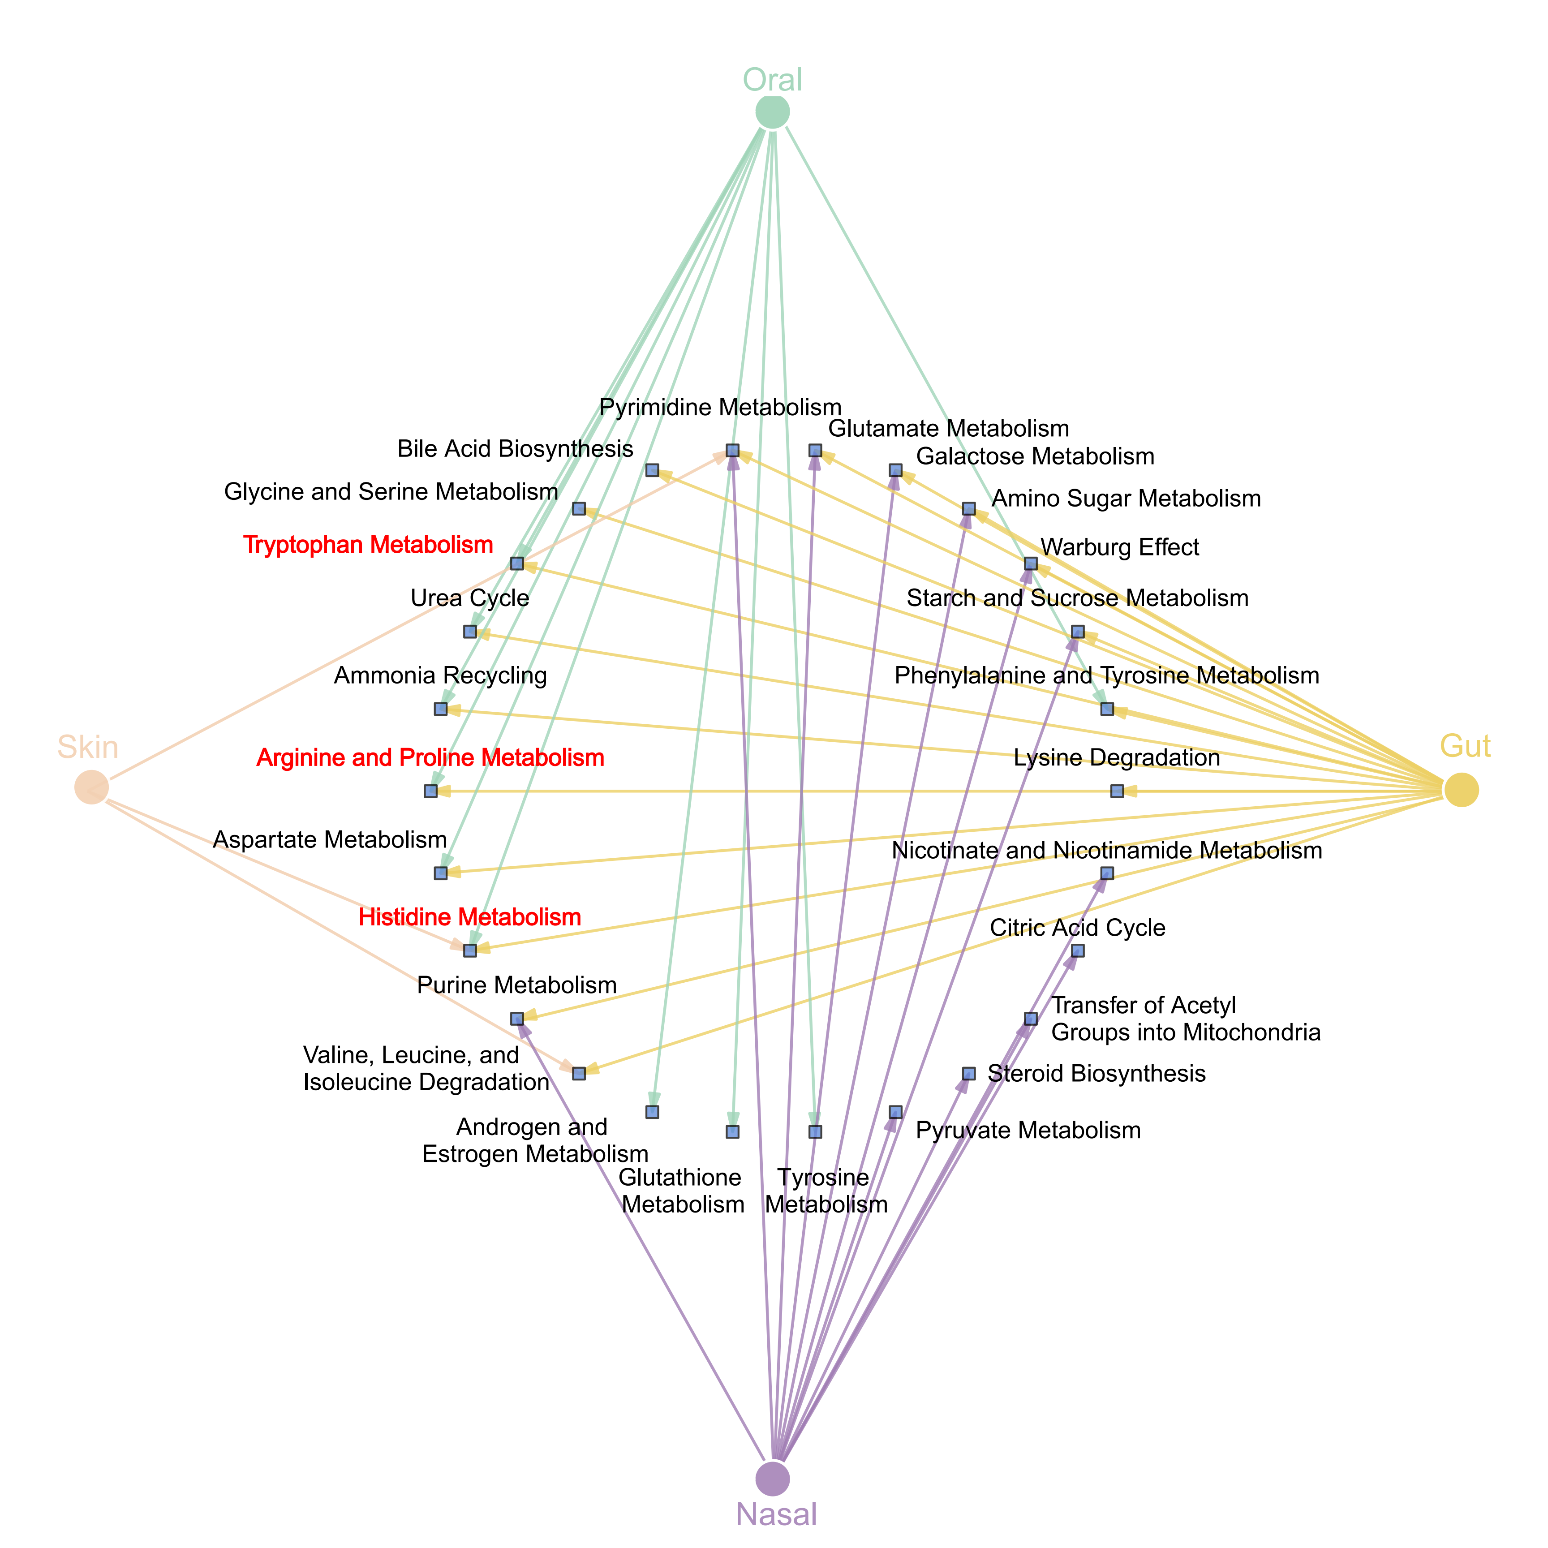
Figure 3

Slide 6
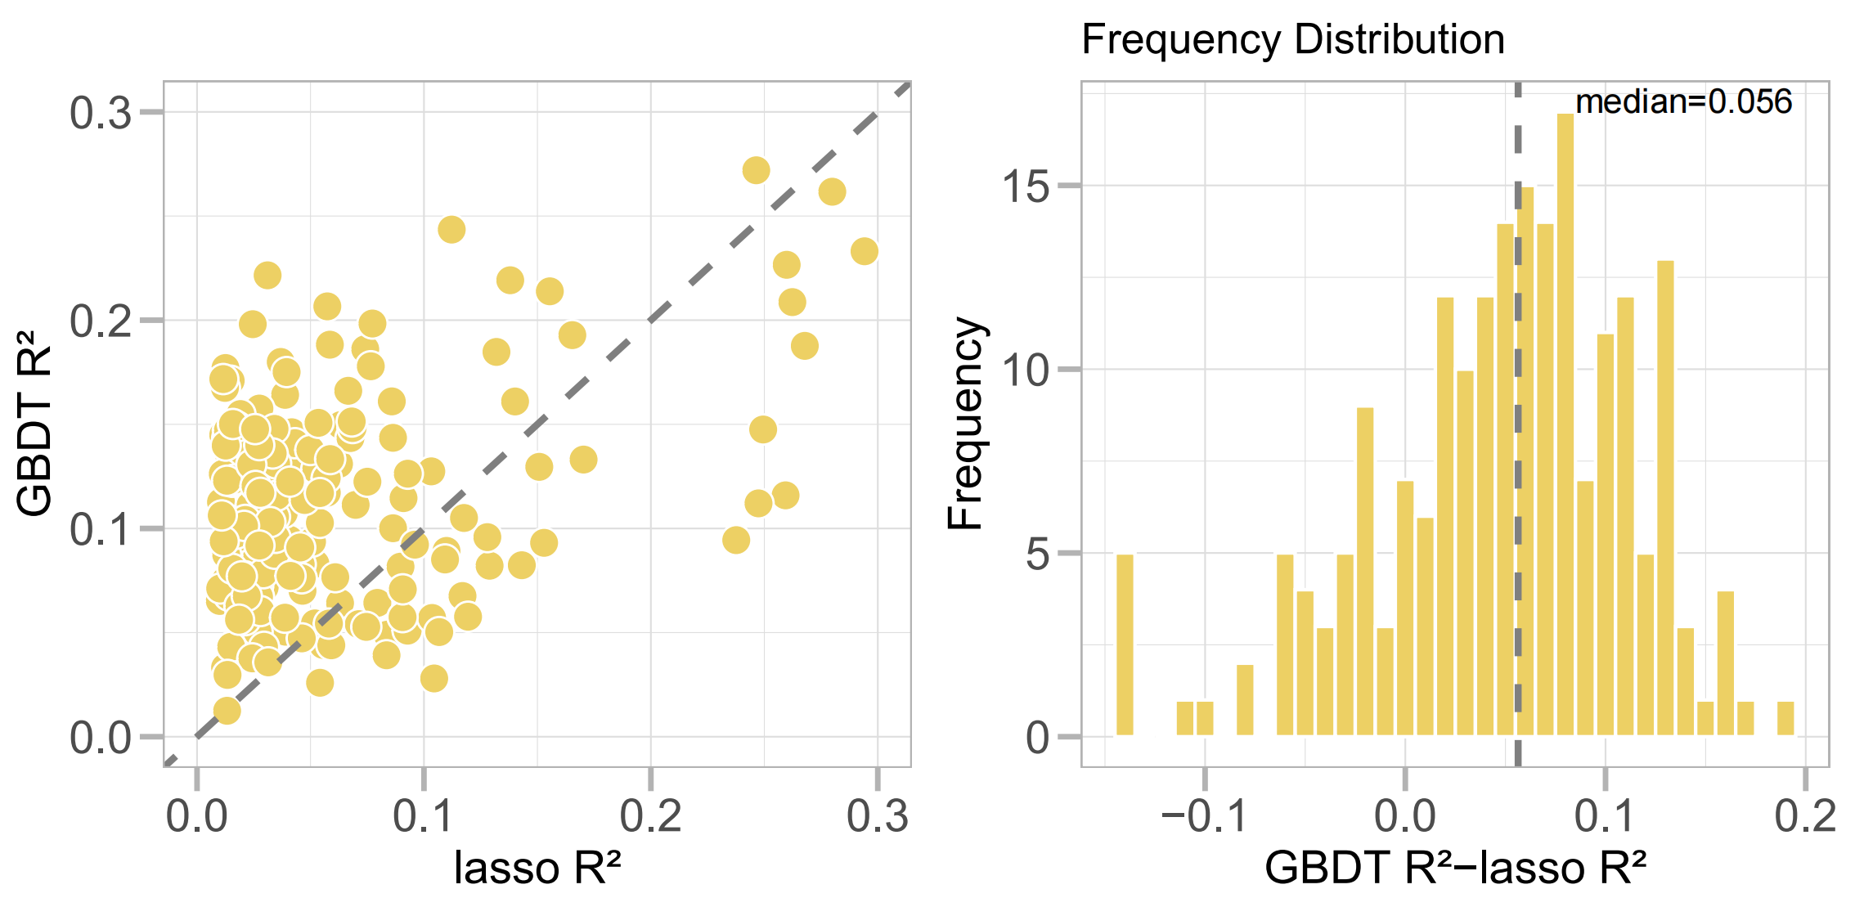
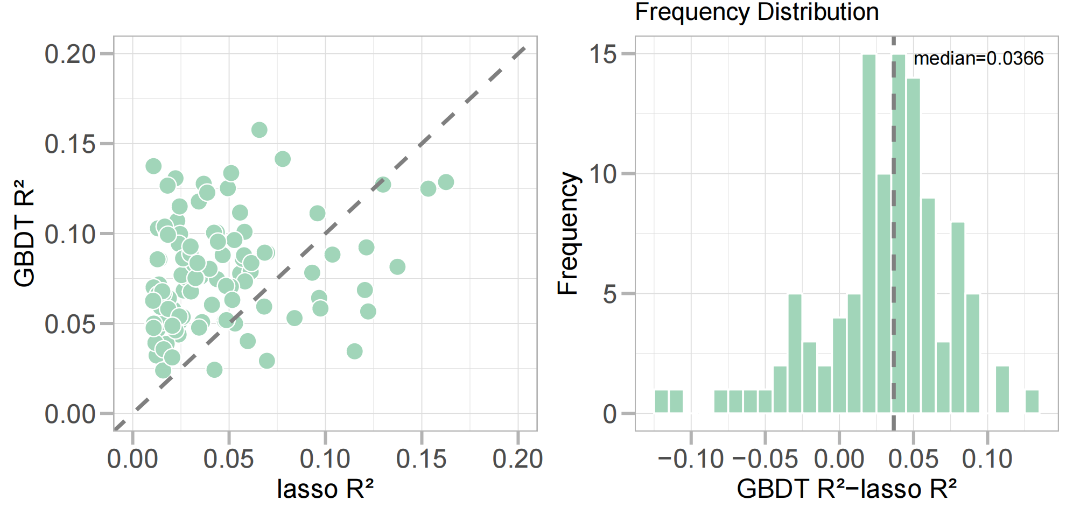
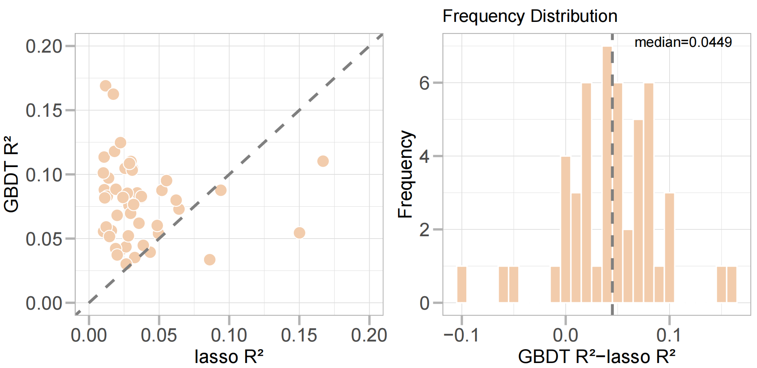
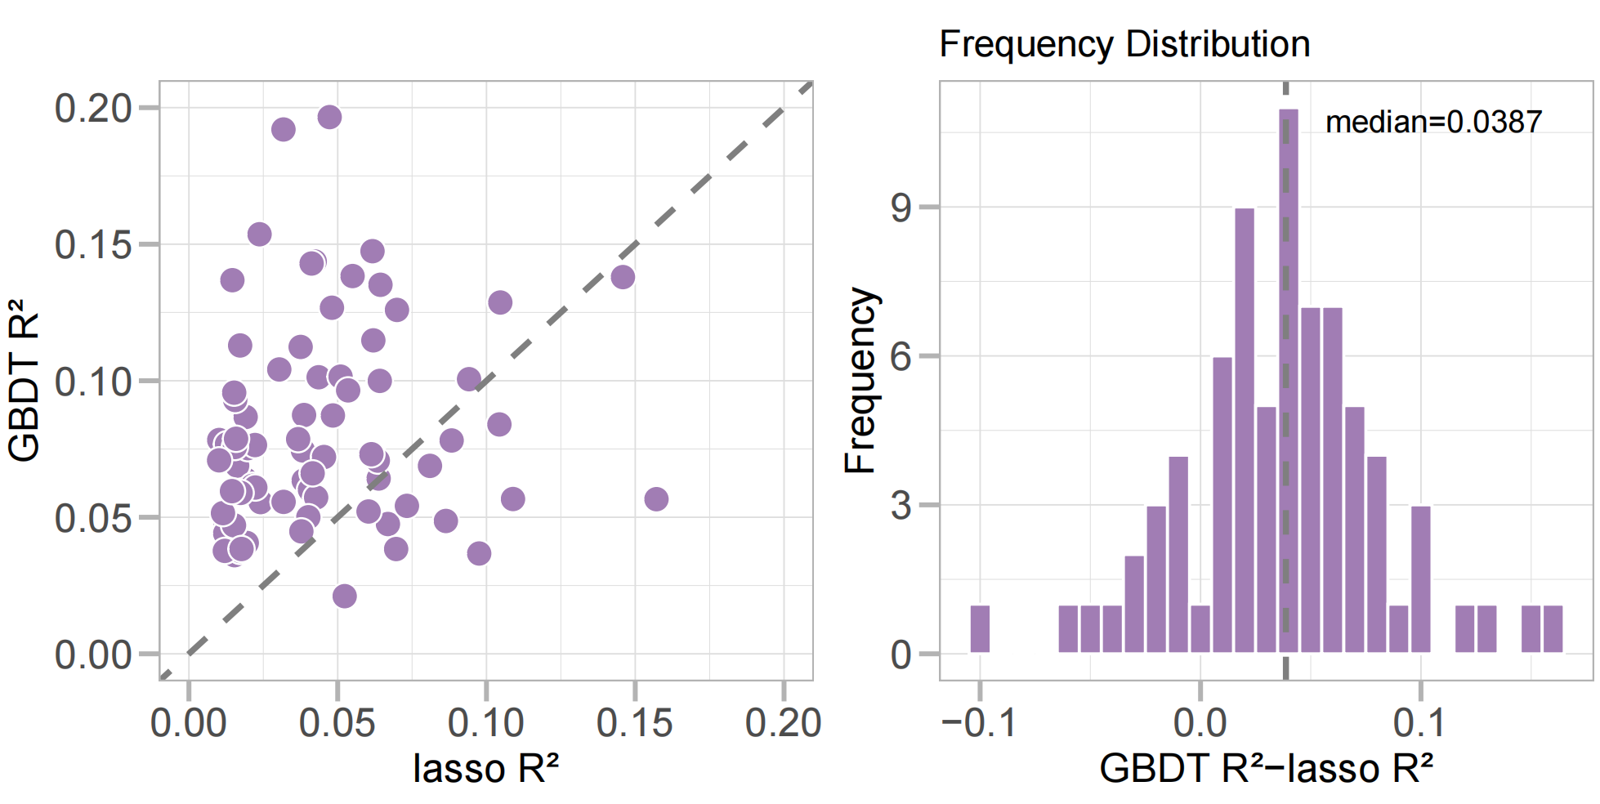
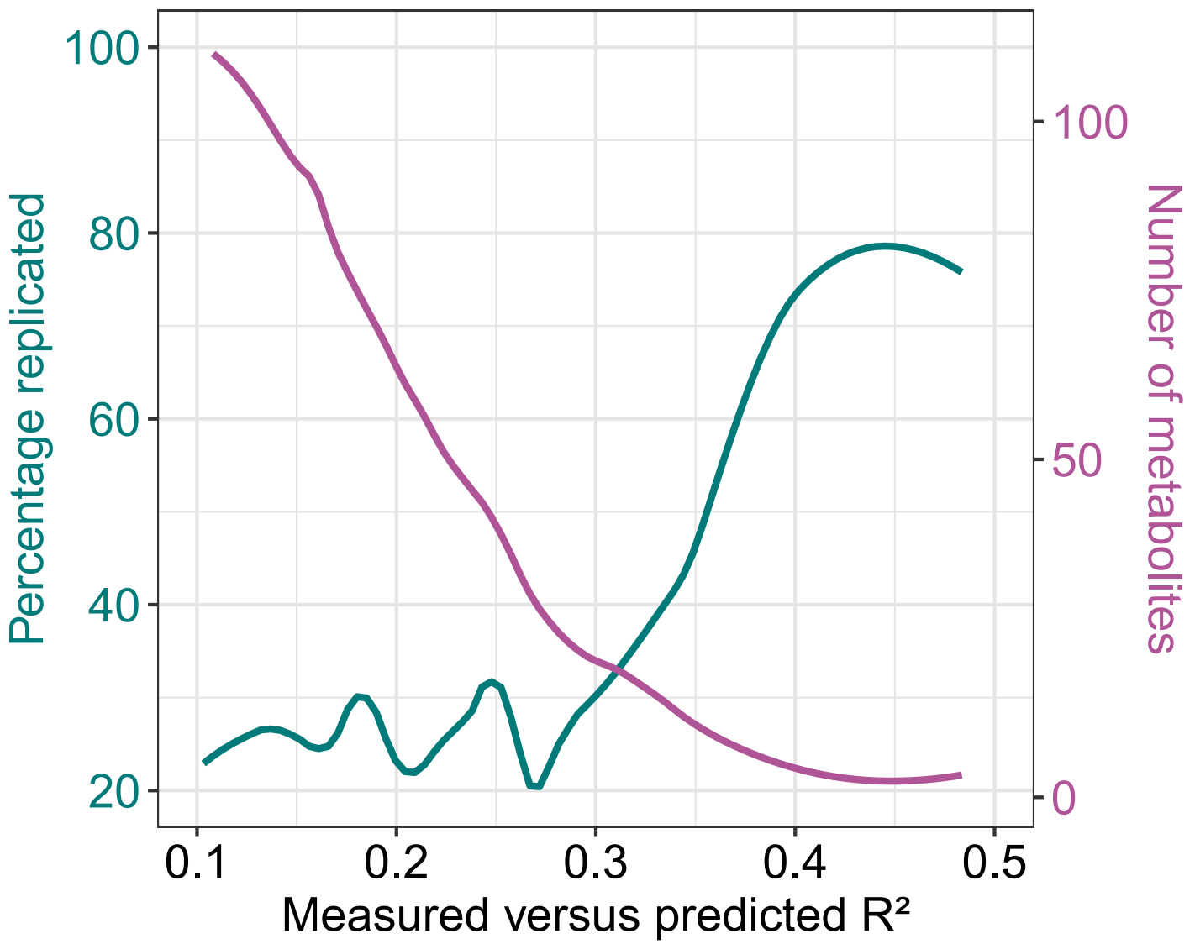
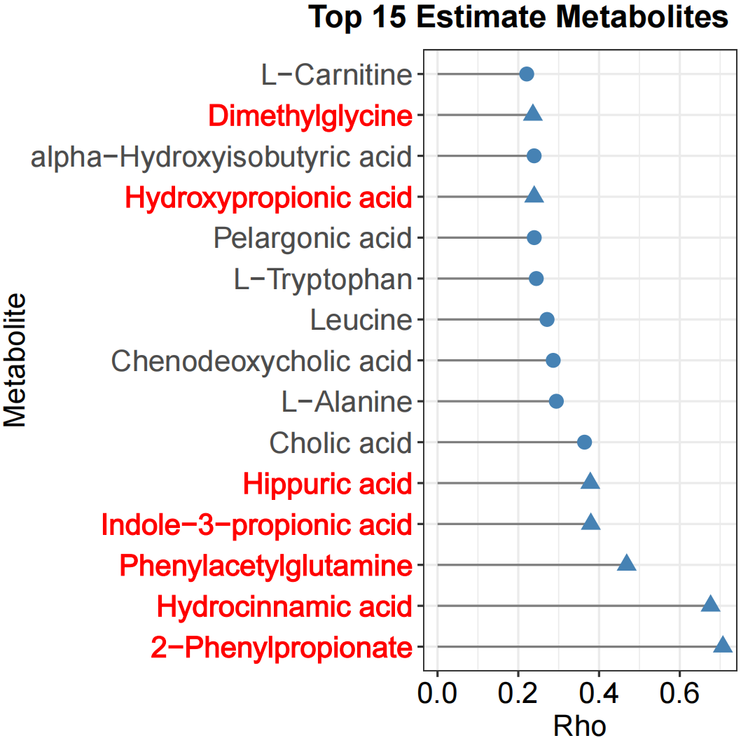
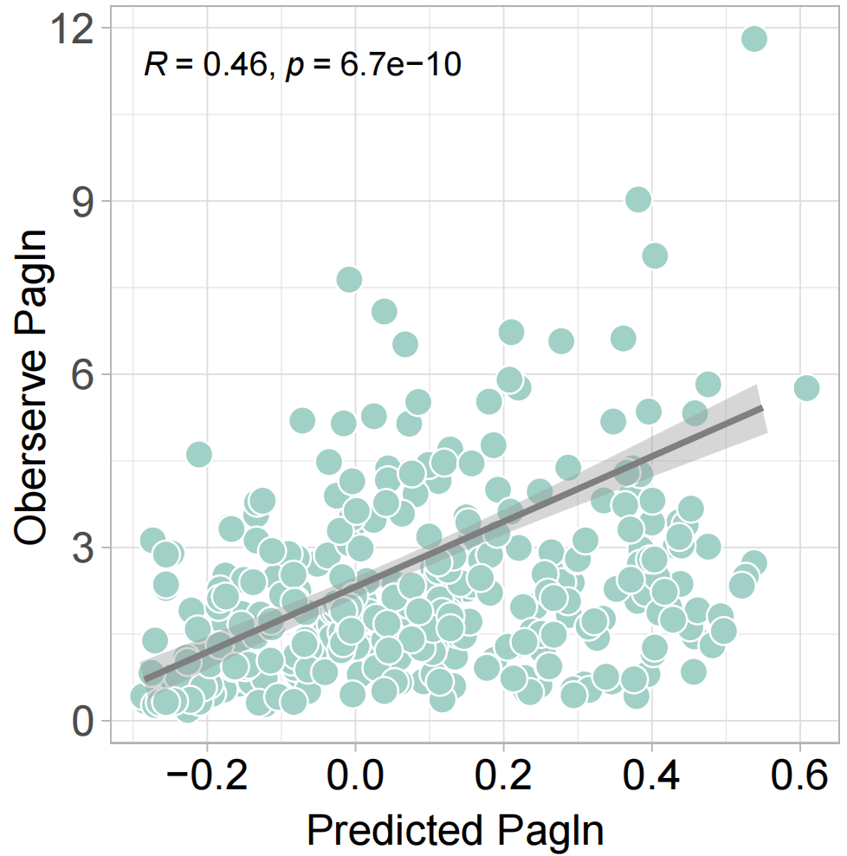
Extended Data Fig. 3
FBIP Cohort

Slide 7
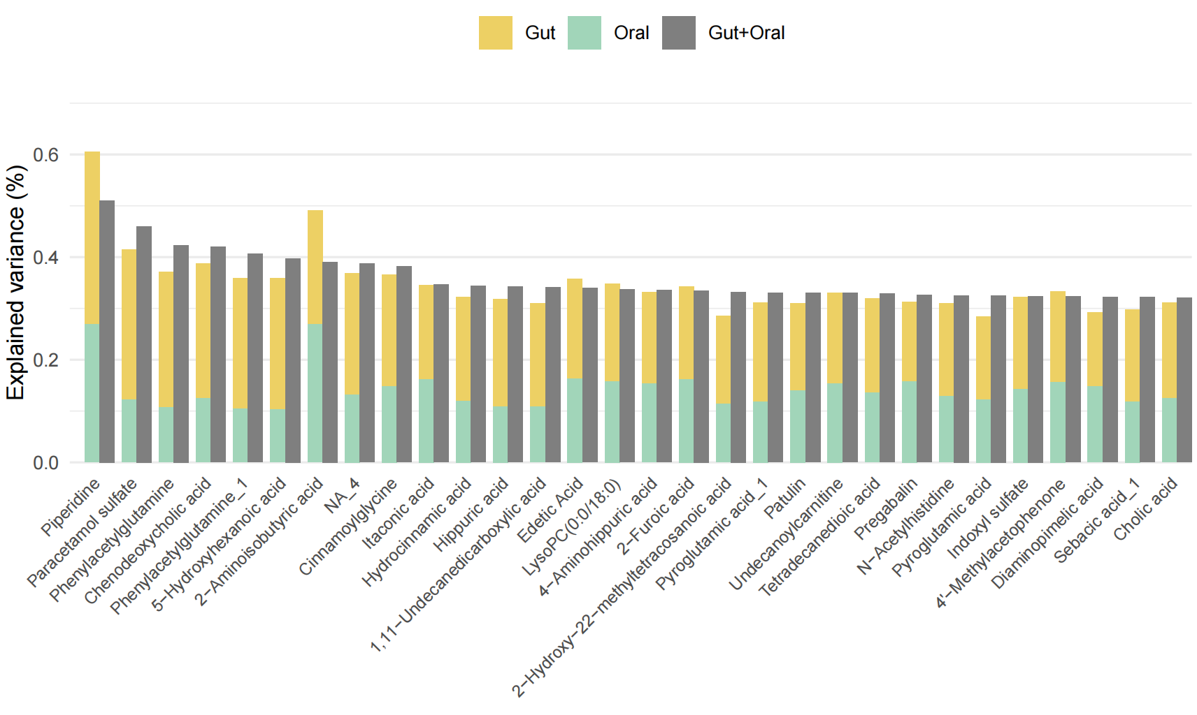
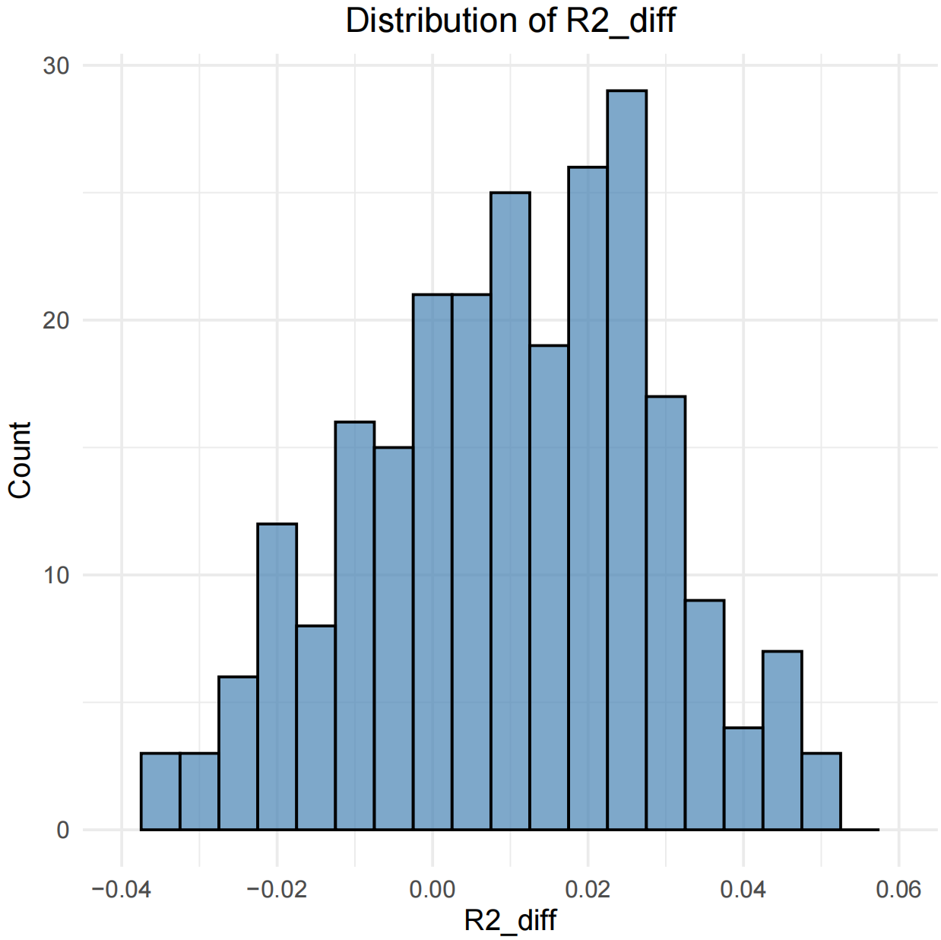
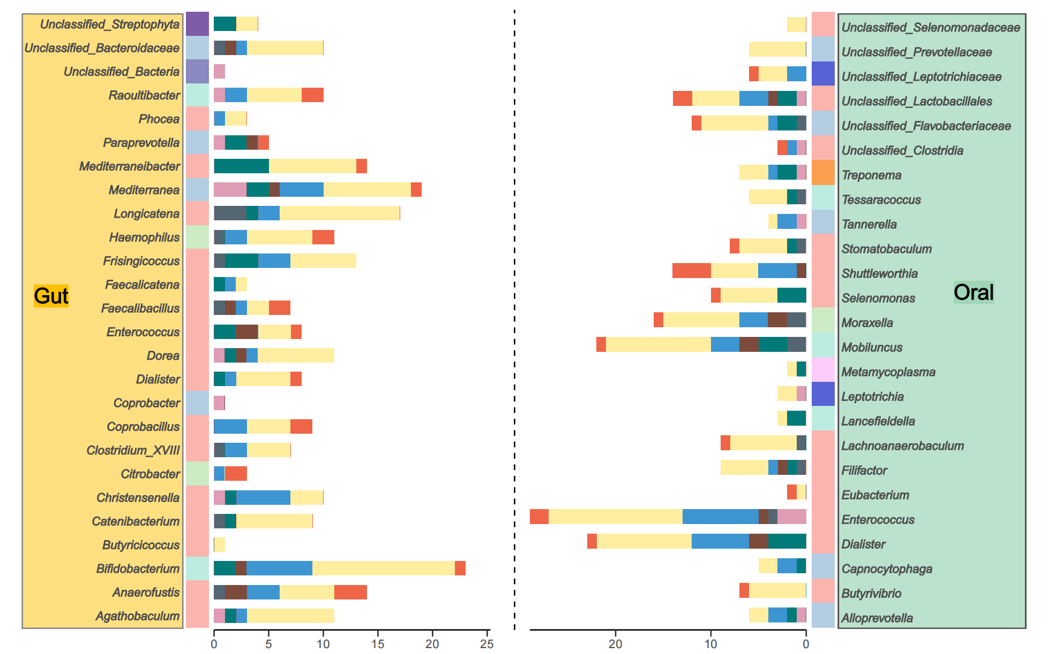
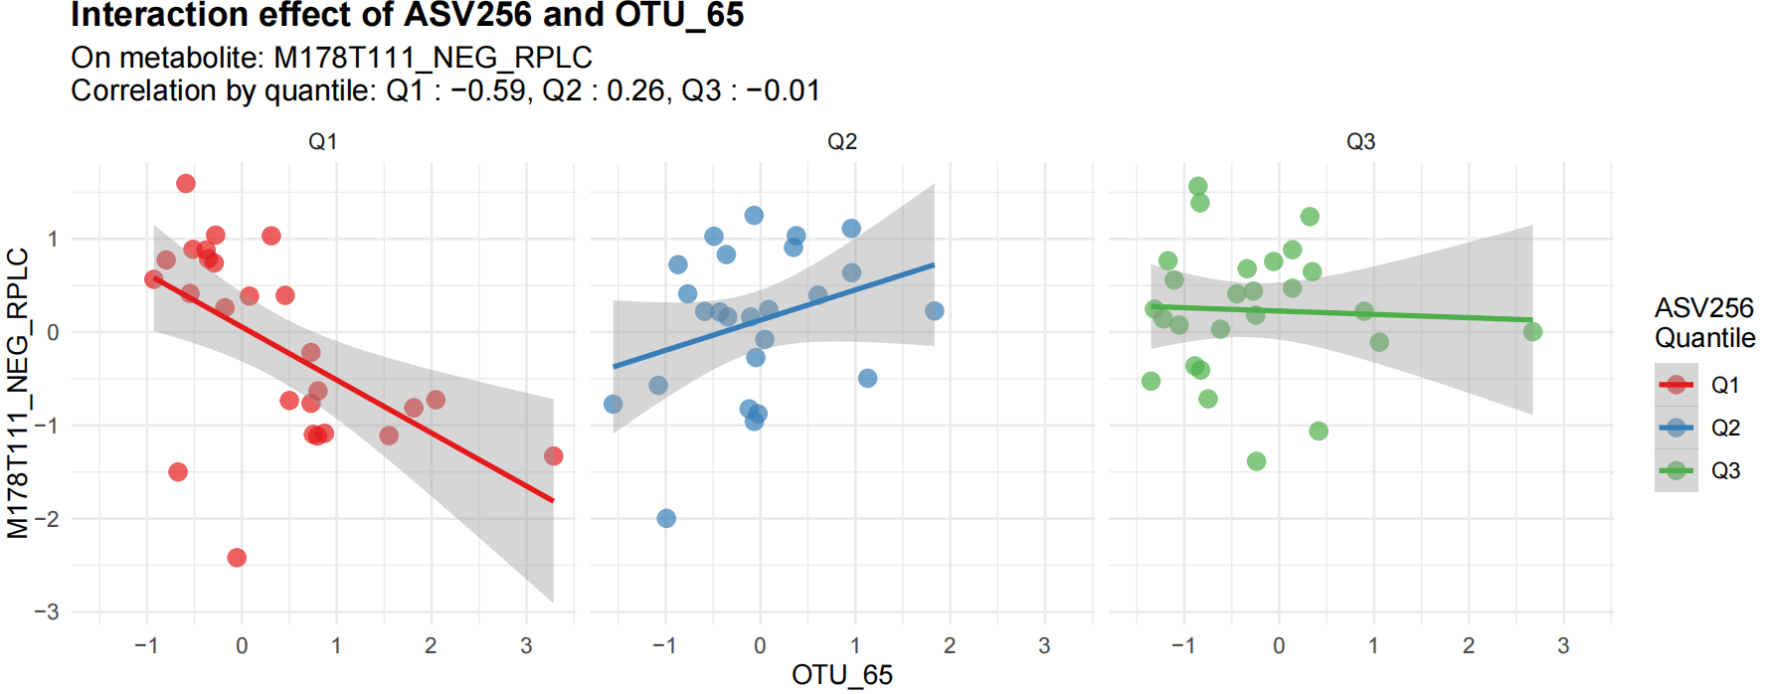
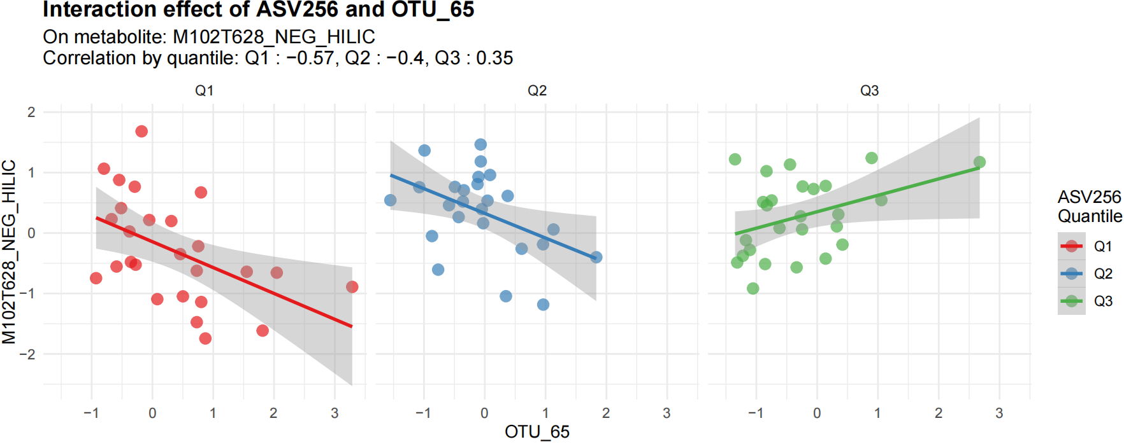
Figure 4
不同HMDBclass的情况
微生物来源的情况

Slide 8
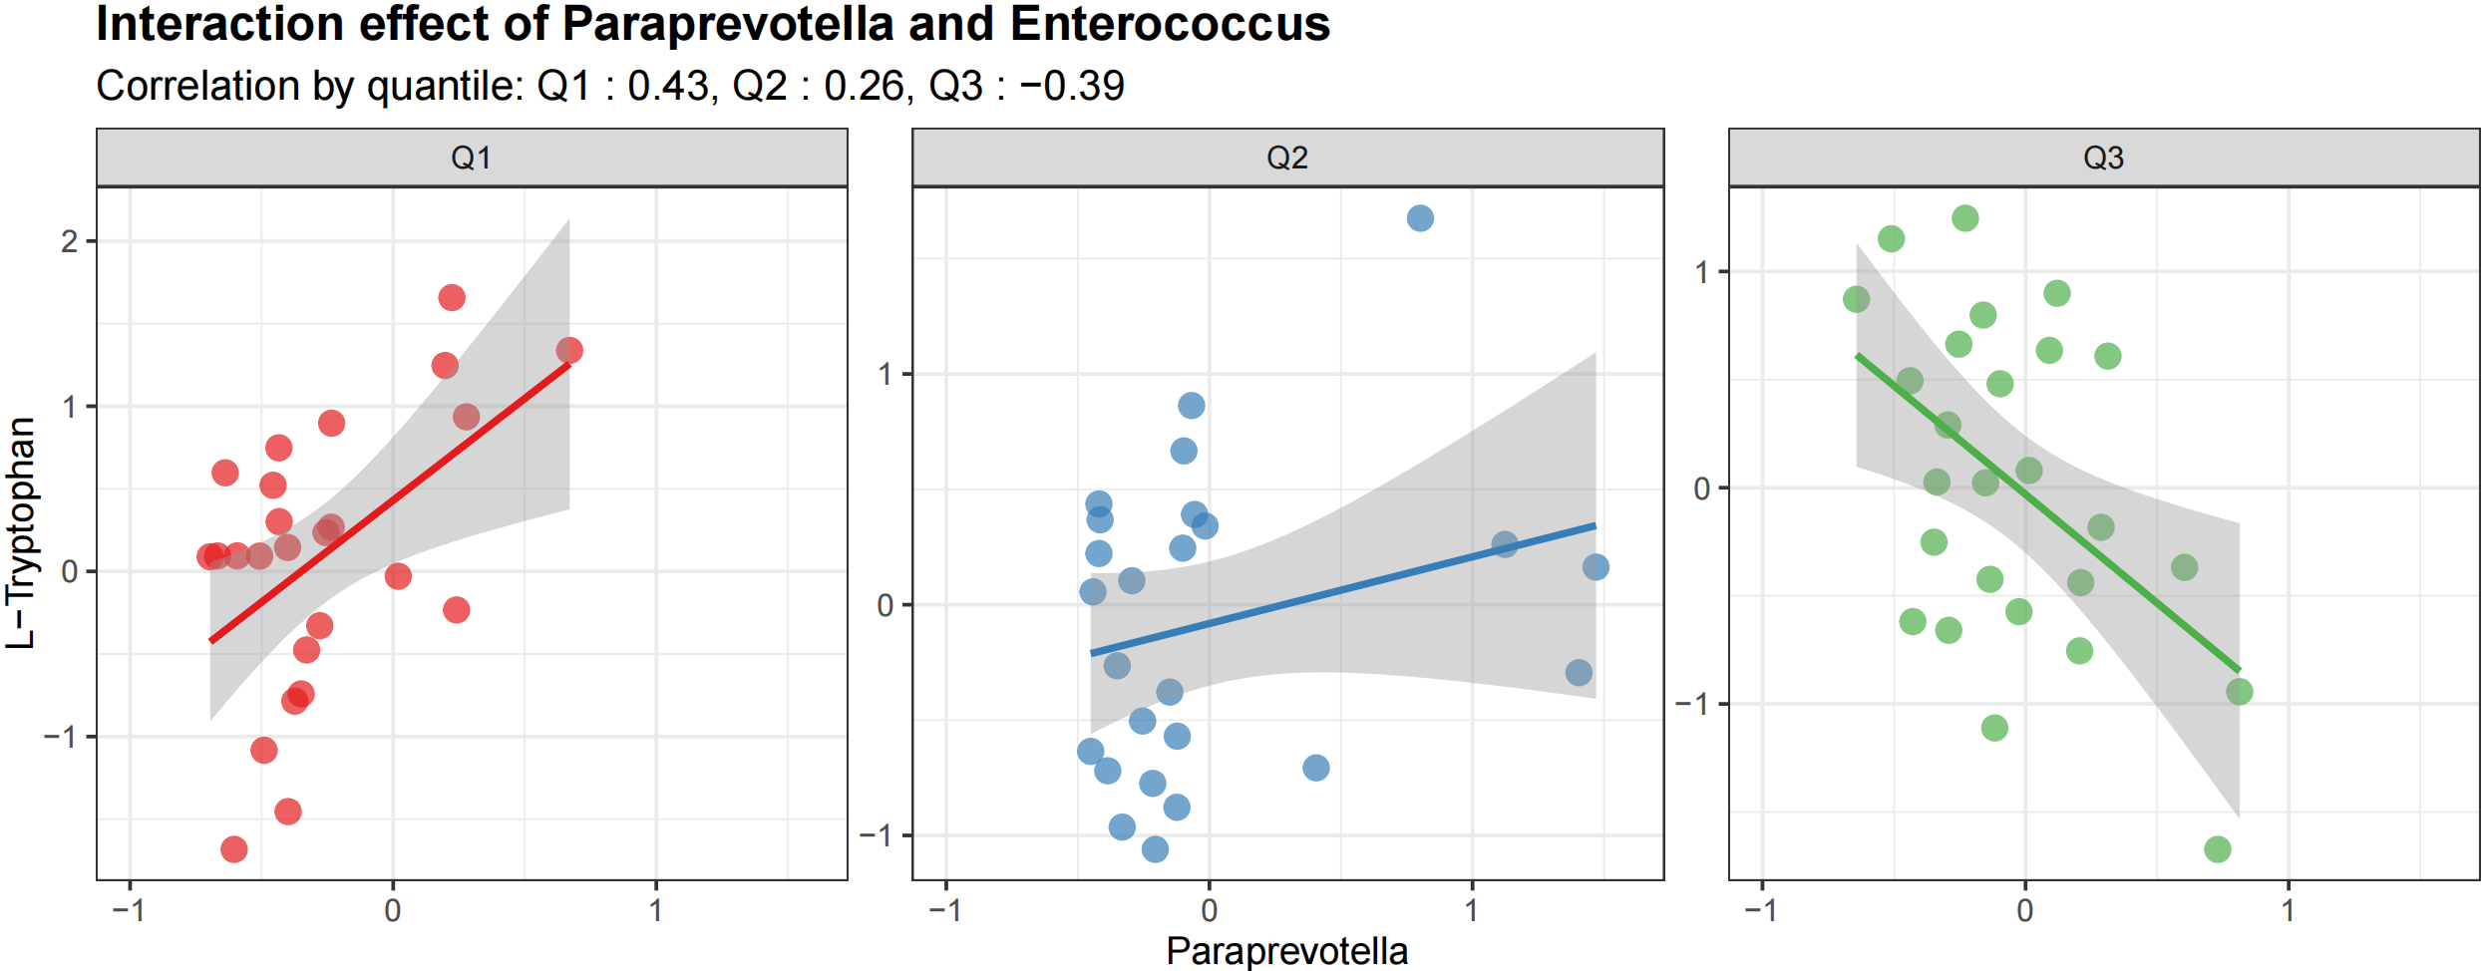
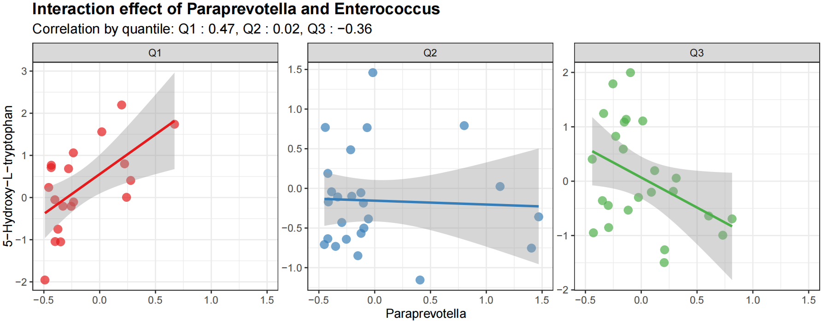



Slide 9



Extended Data Fig. 4

Slide 10


a
Gut Microbiome
Metabolome
Oral Microbiome
Figure 5
b
c
Oscillibacter
d
Oscillibacter
rho = 0.23 P = 0.04
rho = 0.26 P = 0.02
AEC = 0.22 Pmdei = 0.03
rho = 0.55 P < 0.001
AEC = 0.15 Pmdei = 0.004
rho = 0.56 P < 0.001
Dialister
rho = 0.17 P = 0.13
P-Cresol sulfate
Lancefieldella
rho = 0.15
P = 0.15
PAGIn
e
Phocaeicola
f
Coraliomargarita
rho = -0.25 P = 0.03
rho = 0.71 P < 0.001
AEC = 0.12 Pmdei = 0.04
rho = -0.59 P < 0.001
AEC = 0.25
Pmdei = 0.028
rho = 0.56 P < 0.001
rho = 0.07 P = 0.51
Paracetamol sulfate
rho = 0.50
P < 0.001
Piperidine
Granulivatella
Aminipila
Oral bacteira
Gut bacteira
Metabolite

Slide 11

Extended Data Fig. 5
Oscillibacter
Oscillibacter
rho = 0.19
P = 0.036
rho = 0.19
P = 0.036
rho = 0.40 P < 0.001
AEC = 0.07 Pmdei = 0.01
rho = 0.36
P < 0.001
AEC = 0.08 Pmdei = 0.008
Dialister
rho = 0.04
P = 0.64
P-Cresol sulfate
Dialister
rho = -0.02 P = 0.77
PAGln

Slide 12


